Slide 1

Verification of national weather service spot forecasts using surface observations
Matthew Robert Lammers
Master’s Thesis Defense
14 May 2014
Funded by the Joint Fire Science Program

Slide 2
outline
Introduction
Motivation
Objectives
What are Spot Forecasts?
How Do We Verify Spot Forecasts?
Surface Observations
Text Parsing
Visualizing Forecasts and Verifying Data
Giving the User Control
Box Creek Prescribed Burn Escape Case Study
Eureka (EKA) Weather Forecast Office Case Study
All Forecast Offices
Prescribed Burns
Wildfires
Conclusion
Summary
Recommendations
The Transition to Operations

Slide 3
outline
Introduction
Motivation
Objectives
What are Spot Forecasts?
How Do We Verify Spot Forecasts?
Surface Observations
Text Parsing
Visualizing Forecasts and Verifying Data
Giving the User Control
Box Creek Prescribed Burn Escape Case Study
Eureka (EKA) Weather Forecast Office Case Study
All Forecast Offices
Prescribed Burns
Wildfires
Conclusion
Summary
Recommendations
The Transition to Operations

Slide 4
MOTIVATION
Fire Weather Research: A Burning Agenda for NOAA 2008 Report Recommendation 11.2
“NOAA should…Provide fire weather forecast verification and validation information and include performance standards for each forecast element” (NOAA SAB 2008)
Fires in San Diego in 2003 and in Colorado in 2012-13 burned a combined 4617 homes; Yarnell Hill Fire in 2013 caused the deaths of 19 firefighters.
Expansion of the wildland-urban interface has made accuracy in fire danger forecasting a more pressing issue.

Slide 5
objectives
To facilitate the transfer from research to operations of methodologies to verify spot forecasts
To devise approaches to assess the degree of improvement provided by such forecasts relative to those available from the National Digital Forecast Database (NDFD)
To develop examples of web tools that could transition into a product usable by the National Weather Service Performance Branch

Slide 6
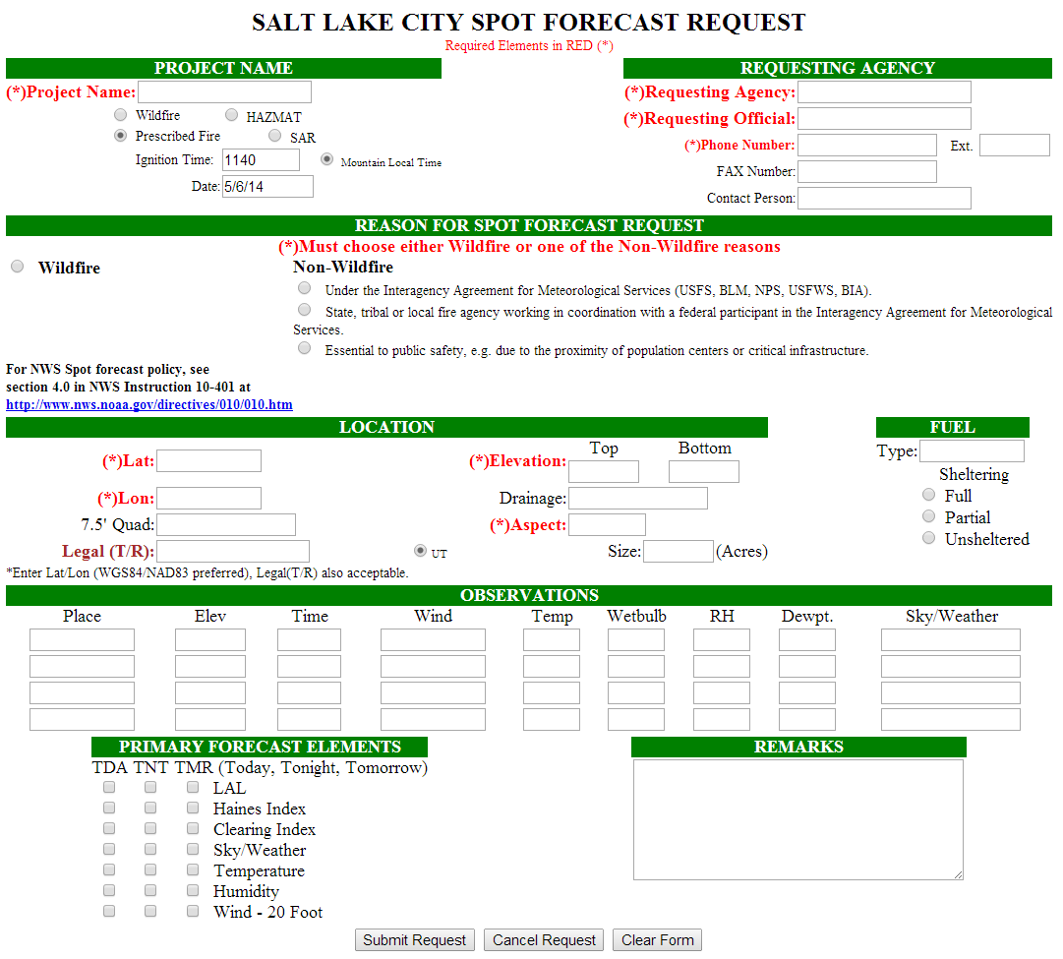
Spot Forecasts
Notes:
Fire Professional using an online form…
Forecast elements can change depending on office

Slide 7
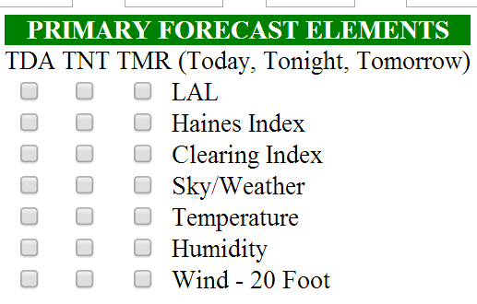
Spot Forecasts
Checked variables were used predominately for the verification process
Notes:
Fire Professional using an online form…
Forecast elements can change depending on office

Slide 8
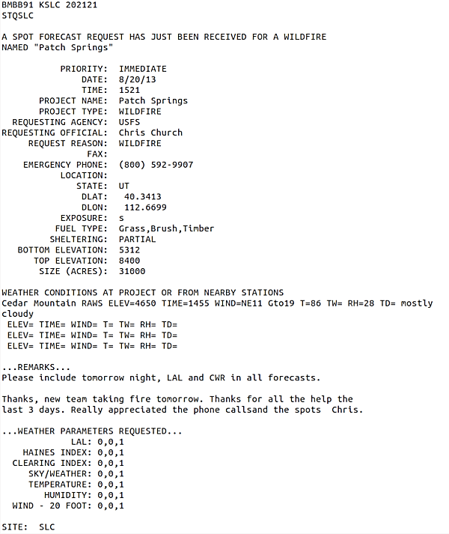
Spot Forecasts
Spot Forecast Request
Notes:
Fire Professional using an online form
Requests are formatted much more regularly than the forecasts themselves
Contain information concerning fuel types
Location, Sheltering, Recent Nearby Weather Observations
What parameters they want to see (Temp, RH, also Haines Index and Lightning Activity Level)

Slide 9
Spot Forecasts
Type of Forecast (Prescribed Burn, Wildfire, Hazmat, Search and Rescue)
Location used for verification
Elevation used for verification (averaged together)
Spot Forecast Request
Notes:
Fire Professional using an online form
Requests are formatted much more regularly than the forecasts themselves
Contain information concerning fuel types
Location, Sheltering, Recent Nearby Weather Observations
What parameters they want to see (Temp, RH, also Haines Index and Lightning Activity Level)

Slide 10
Spot Forecasts
Type of Forecast (Prescribed Burn, Wildfire, Hazmat, Search and Rescue)
Location used for verification
Elevation used for verification (averaged together)
Important additional information/feedback for forecaster
Requested parameters, used for determining if forecast will have fields for verification
Spot Forecast Request
Notes:
Fire Professional using an online form
Requests are formatted much more regularly than the forecasts themselves
Contain information concerning fuel types
Location, Sheltering, Recent Nearby Weather Observations
What parameters they want to see (Temp, RH, also Haines Index and Lightning Activity Level)

Slide 11
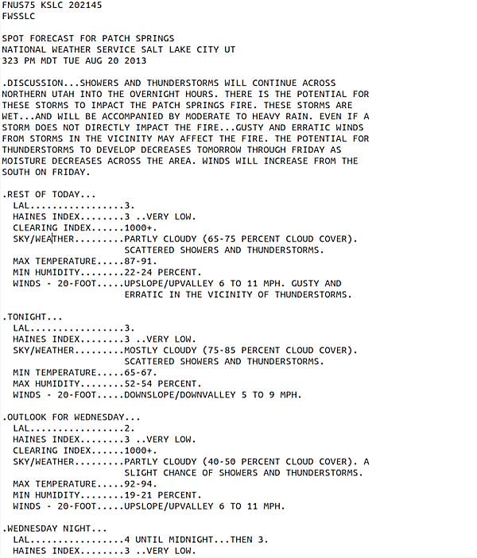
Spot Forecasts
Spot Forecast

Slide 12
Spot Forecasts
The Discussion section outlines potential hazards or condition changes that might impact fire behavior
Spot Forecast

Slide 13
Spot Forecasts
The Discussion section outlines potential hazards or condition changes that might impact fire behavior
The first section detailing the anticipated values for the atmospheric variables requested in the Request Form – for this study, had to be for “Today” or “Rest of Today”
Spot Forecast

Slide 14
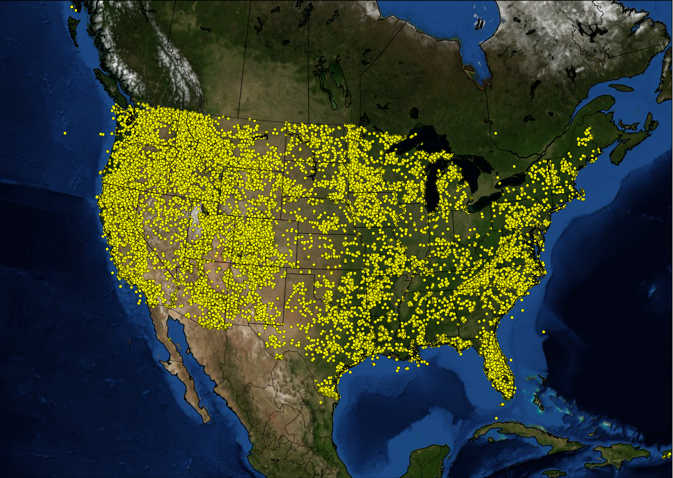
Spot Forecasts
Total Forecasts: 103370
All Spot Forecasts April 1, 2009 to November 30, 2013
Notes:
- All of the spot forecasts for the CONUS
- Some forecast offices are much busier than others when it comes to issuing spot forecasts, especially those with large forested areas or regions with high likelihood of fire

Slide 15
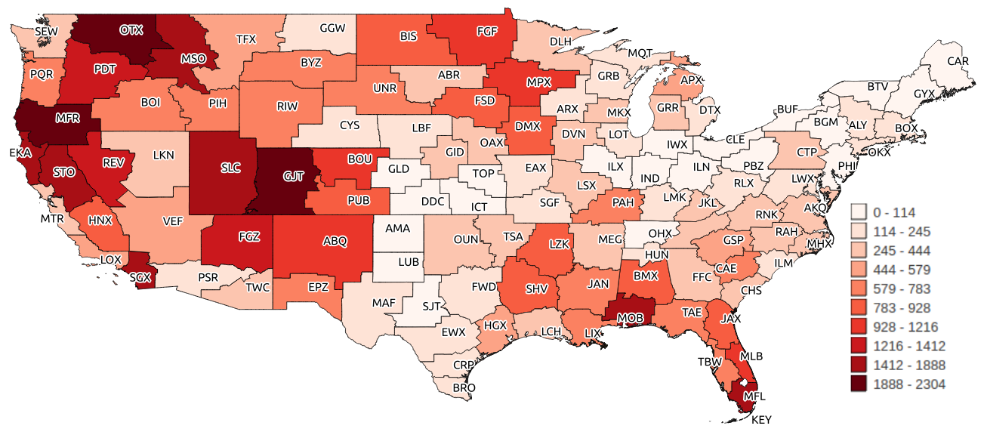
Spot Forecasts
Total Forecasts: 64346
Prescribed Burn Spot Forecasts April 1, 2009 to November 30, 2013
Notes:
Decent number of forecasts in every WFO (even white areas can have as many as 114 forecasts)
Almost twice as many prescribed burn forecasts as there are wildfire spot forecasts
Labels are three-letter designations for each forecast office in the CONUS

Slide 16
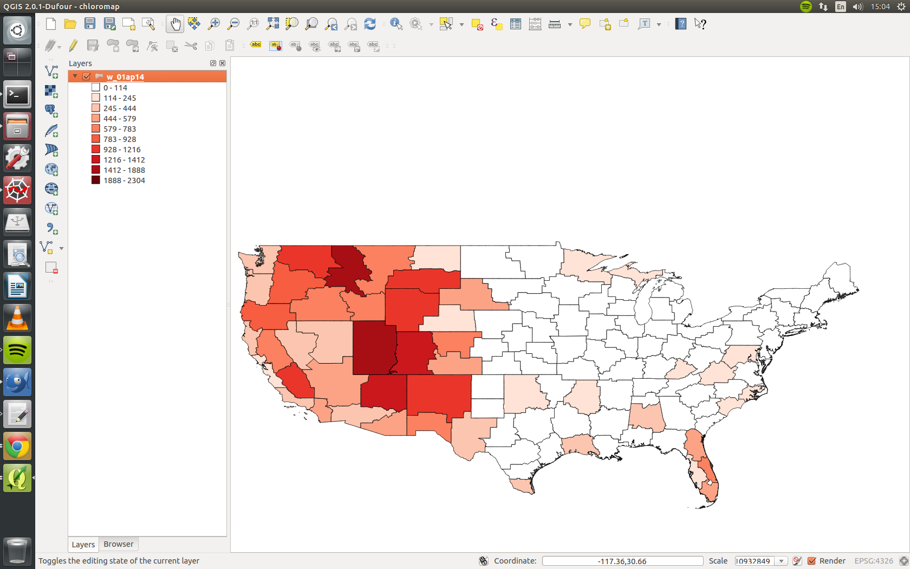
Spot Forecasts
Total Forecasts: 31290
Wildfire Spot Forecasts April 1, 2009 to November 30, 2013
Notes:
Conversely, there are large areas without wildfire spot forecasts, and they are heavily concentrated in the Western US, Florida, the Appalachians, Ozarks, and Northern Minnesota/Michigan
Make point about Incident Meteorologist taking over when wildfire becomes large/complex

Slide 17
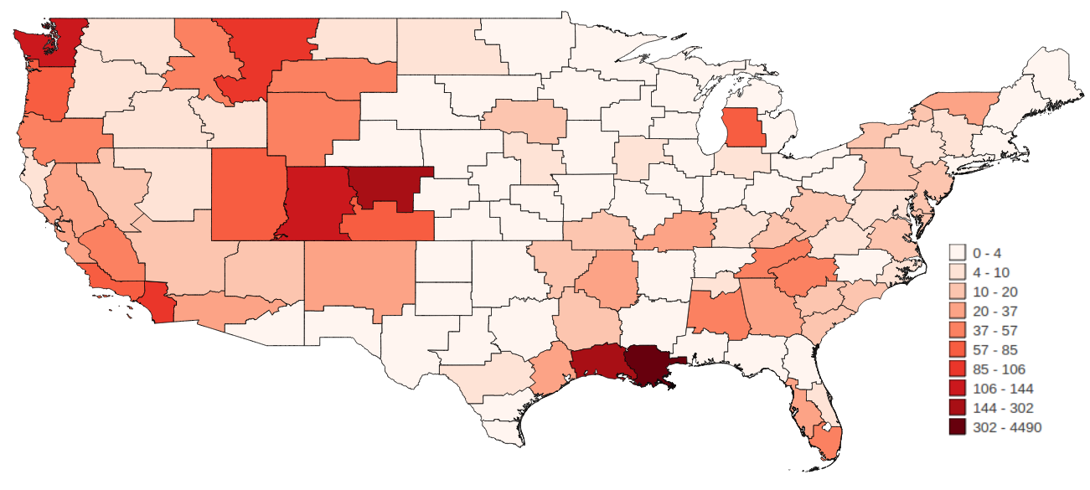
Spot Forecasts
Total Forecasts: 7276
Other Spot Forecasts April 1, 2009 to November 30, 2013
Notes:
The final categories for spot forecasts are “Search and Rescue” and “Hazardous Materials”.
A note – 90% of Hazmat spot forecasts in this sample were issued for the Gulf Oil spill off the coast of Louisiana (4490 total issued by New Orleans)

Slide 18
Spot Forecasts
Prescribed Burns
FORECAST CREATION PROCESS
Wildfires
A request is typically received the evening before a prescribed burn is ignited
The forecaster on duty replies to the requestor notifying them that the form has been received
Initial writing-up of the forecast may occur in the overnight period
Final numerical values are added in the early morning
A request is received once a wildfire has been detected or declared
The forecaster on duty responsible for issuing spot forecasts looks at existing guidance and discussions contained in their Graphical Forecast Editor (GFE)
Spot forecast is generated for the wildfire location, typically within a matter of minutes
Notes:
Can be different from office to office; simply my understanding of the difference between the two forecast processes

Slide 19
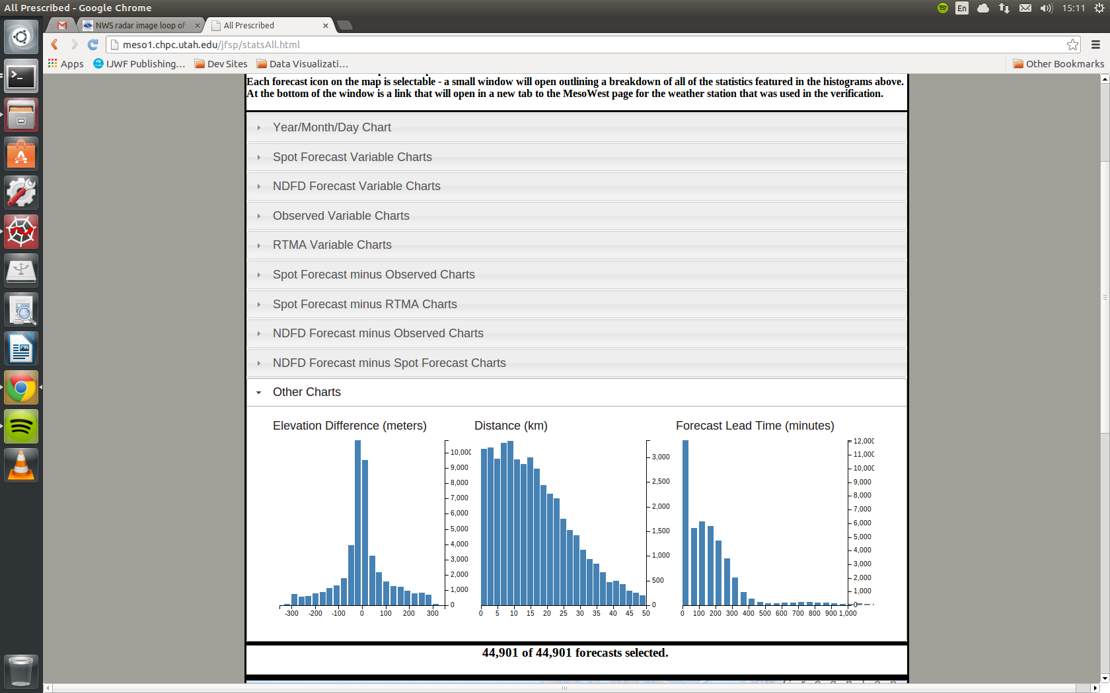
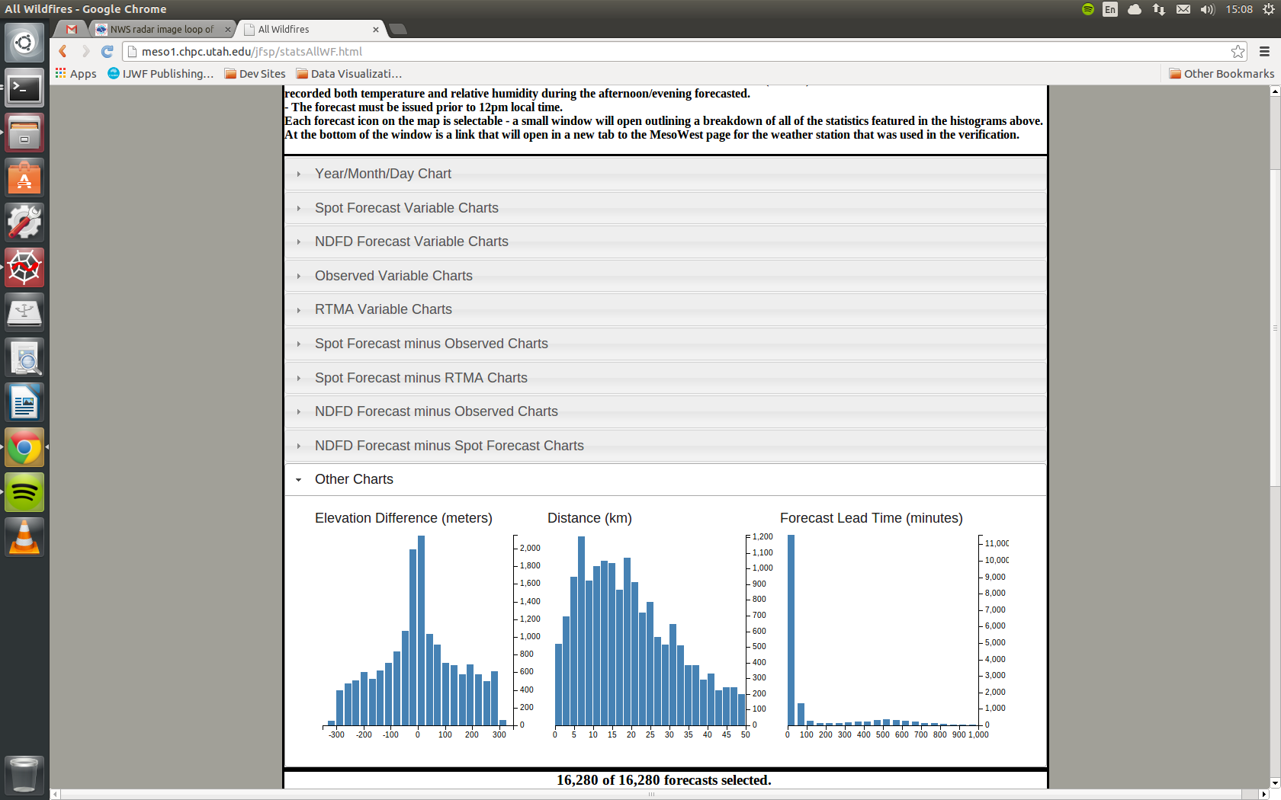
Spot Forecasts
Hours
0 5 10 15 5 10 15
Prescribed Burns
Wildfires
Notes:
Lead time is calculated as difference between time of request submission and time of forecast issuance
Much larger percentage of wildfire forecasts issued within 50 minutes after request than prescribed burn forecasts

Slide 20
NDFD Forecasts
The National Digital Forecast Database (NDFD) contains gridded forecasts issued by Weather Forecast Offices (Glahn and Ruth 2003)
Forecasts are updated on a regular basis throughout the day
Trained forecasters take model output statistics, local forecast products, and their own experience to generate gridded forecasts for the entire County Warning Area (CWA)

Slide 21
outline
Introduction
Motivation
Objectives
What are Spot Forecasts?
How Do We Verify Spot Forecasts?
Surface Observations
Text Parsing
Visualizing Forecasts and Verifying Data
Giving the User Control
Box Creek Prescribed Burn Escape Case Study
Eureka (EKA) Weather Forecast Office Case Study
All Forecast Offices
Prescribed Burns
Wildfires
Conclusion
Summary
Recommendations
The Transition to Operations

Slide 22
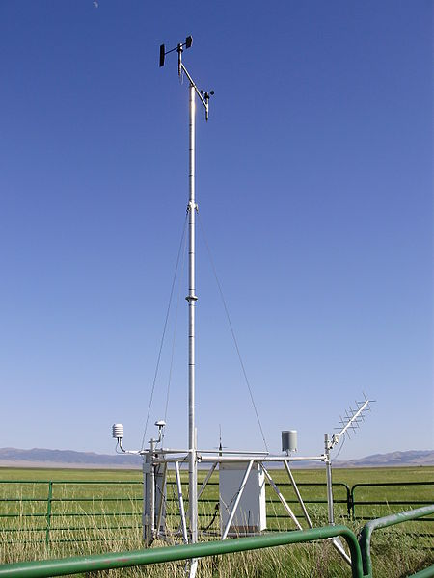
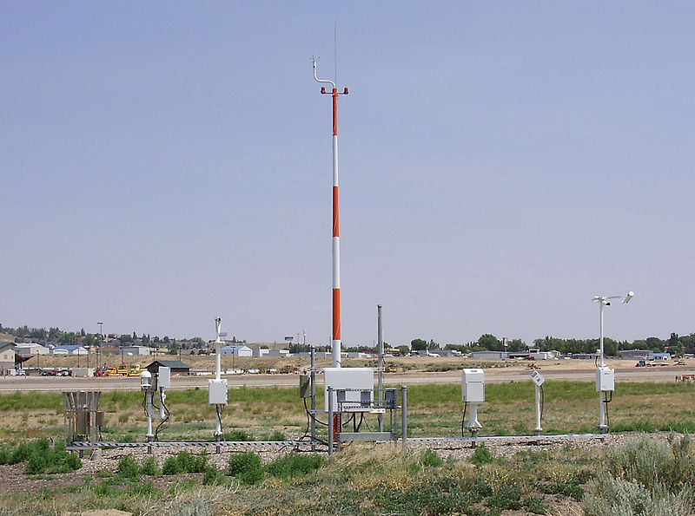
Verifying Datasets - Surface Observations
Elko ASOS (Wikimedia Commons)
Ruby Lake RAWS(Wikimedia Commons)
Notes:
Mention portable RAWS at end of discussion of anemometer heights – don’t have metadata to know the actual height of the sensor, so assume all of RAWS are at 20 feet
Remote Automated Weather Stations
Automated Surface Observing System

Slide 23
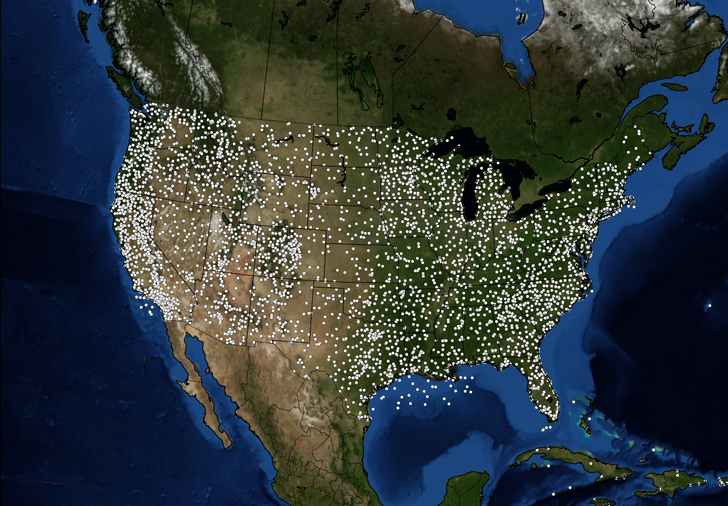
Verifying Datasets - Surface Observations
All Currently Active Stations in NWS/FAA and RAWS Networks
Notes:
- Much more densely concentrated in certain regions, including the Southeast, East Texas, Colorado Front Range, the West Coast
- Very sparsely concentrated in the Great Plains (no RAWS stations, just NWS/FAA) , West Texas, and most of Nevada

Slide 24

Parsing a Spot Forecast
A Natural Language Problem – Interpreting the Intentions of the Forecaster
Notes:
- This was from a 2013 wildfire in Northern Utah (Patch Springs Fire)
- Great deal of smoke over the Salt Lake City area

Slide 25
Parsing a Spot Forecast
A Natural Language Problem – Interpreting the Intentions of the Forecaster
Notes:
- Use some experience to program the text parser in a way that it will handle different sets of numbers in different ways
- So here we have two ranges…

Slide 26
Parsing a Spot Forecast
A Natural Language Problem – Interpreting the Intentions of the Forecaster
89˚F = 31.7˚C
23%
Notes:
So here we have two ranges…from these I take the mean values (because they are ranges)
Set of numbers, I assume they are outlining the progression of temperature through the afternoon, so I just take the maximum value
- This isn’t too difficult of a problem at this point, but then we take a look at the forecast for 20-foot winds…

Slide 27
Parsing a Spot Forecast
A Natural Language Problem – Interpreting the Intentions of the Forecaster
Notes:
- This isn’t too difficult of a problem at this point, but then we take a look at the forecast for 20-foot winds…
- “Upslope/Upvalley 6 to 11 mph. Gusty and erratic in the vicinity of thunderstorms.”

Slide 28
Parsing a Spot Forecast
A Natural Language Problem – Interpreting the Intentions of the Forecaster
11 mi hr⁻¹ = 4.9 m s⁻¹ (?)
Notes:
- Do we verify whether thunderstorms occurred in the area and adjust the verification based on the potential of outflows?
- In our system, we take the highest value before we find the string “GUST”, so 11 mph (or 4.9 mps)

Slide 29
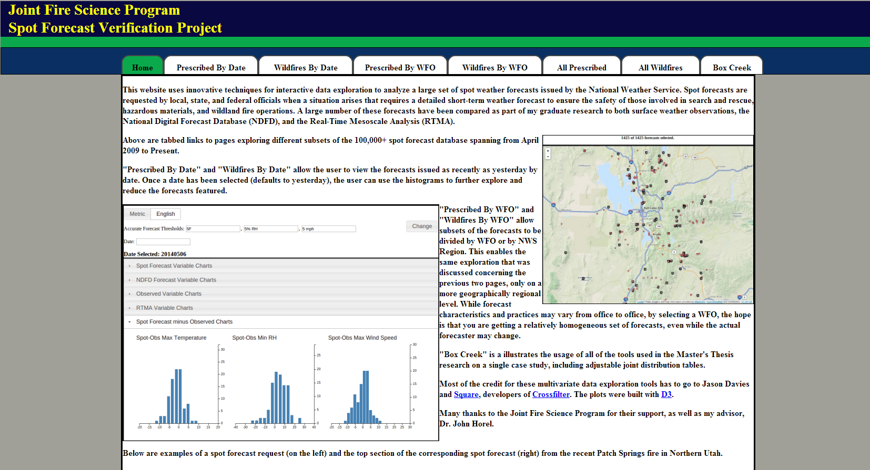
Visualizing forecasts and verifying data
http://meso1.chpc.utah.edu/jfsp
Notes:
When you go to the website below, you will see a landing page giving an overview of what the different tabs contain in terms of selection capabilities
Have pages for prescribed and wildfire forecasts selectable by date; selectable by issuing forecast office; and then all of them
The forecasts are updated daily

Slide 30
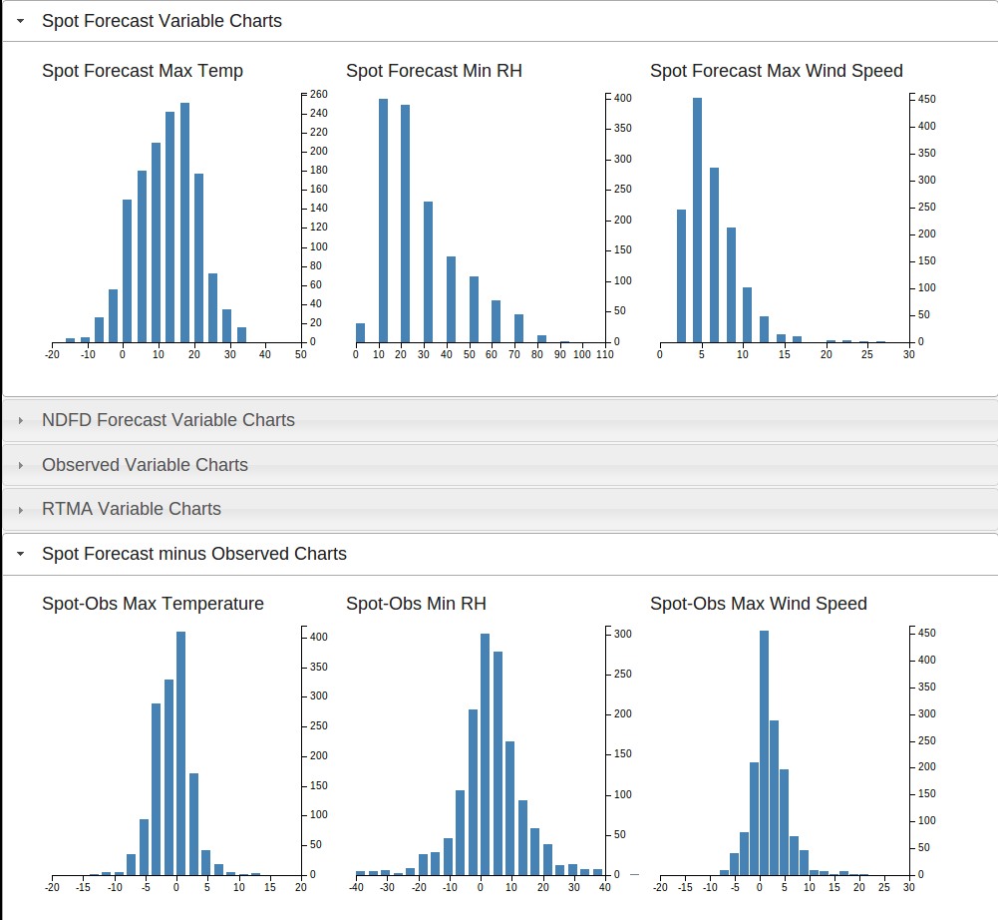
Visualizing forecasts and verifying data
With all of the variables included in the analysis, we needed a way to sift through the impacts of selecting on certain thresholds efficiently and interactively.
(ºC)
(%)
(ms⁻¹)
(ºC)
(%)
(ms⁻¹)
http://meso1.chpc.utah.edu/jfsp
Notes:
- We have versions of the page where you can view all of the spot forecasts for either prescribed burns or wildfires, forecasts by WFO, and forecasts by date
- Uses the open-source Javascript module “Crossfilter,” along with other modules for plotting and organization

Slide 31
Visualizing forecasts and verifying data
By selecting a range of values in any of the histograms, the other distributions will respond accordingly.
(ºC)
(%)
(ms⁻¹)
(ºC)
(%)
(ms⁻¹)
http://meso1.chpc.utah.edu/jfsp
Notes:
- Use brushes to select only forecasts where the forecast maximum wind speed exceeded 10 mps

Slide 32
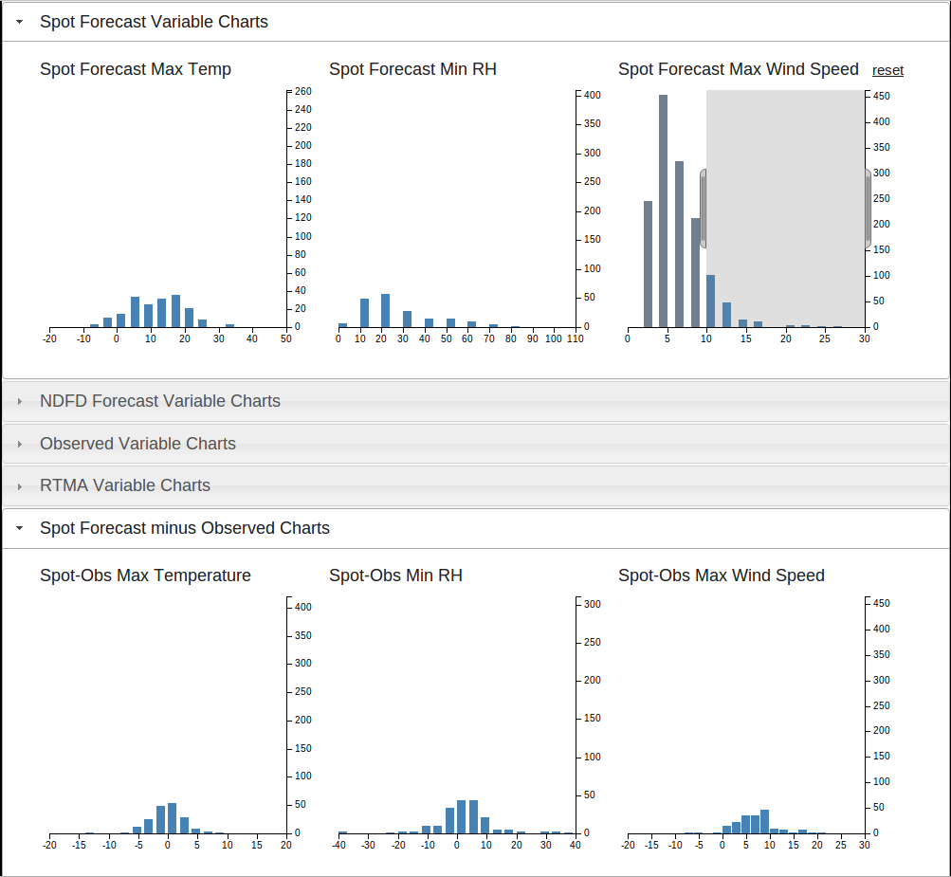
Visualizing forecasts and verifying data
By selecting a range of values in any of the histograms, the other distributions will respond accordingly.
(ºC)
(%)
(ºC)
(%)
(ms⁻¹)
http://meso1.chpc.utah.edu/jfsp
Notes:
- Here we have chosen only those cases where the forecast maximum wind speed exceeded 10 m/s
This should adjust the distribution of errors between the spot forecast and the observation to favor overforecasting and larger errors

Slide 33
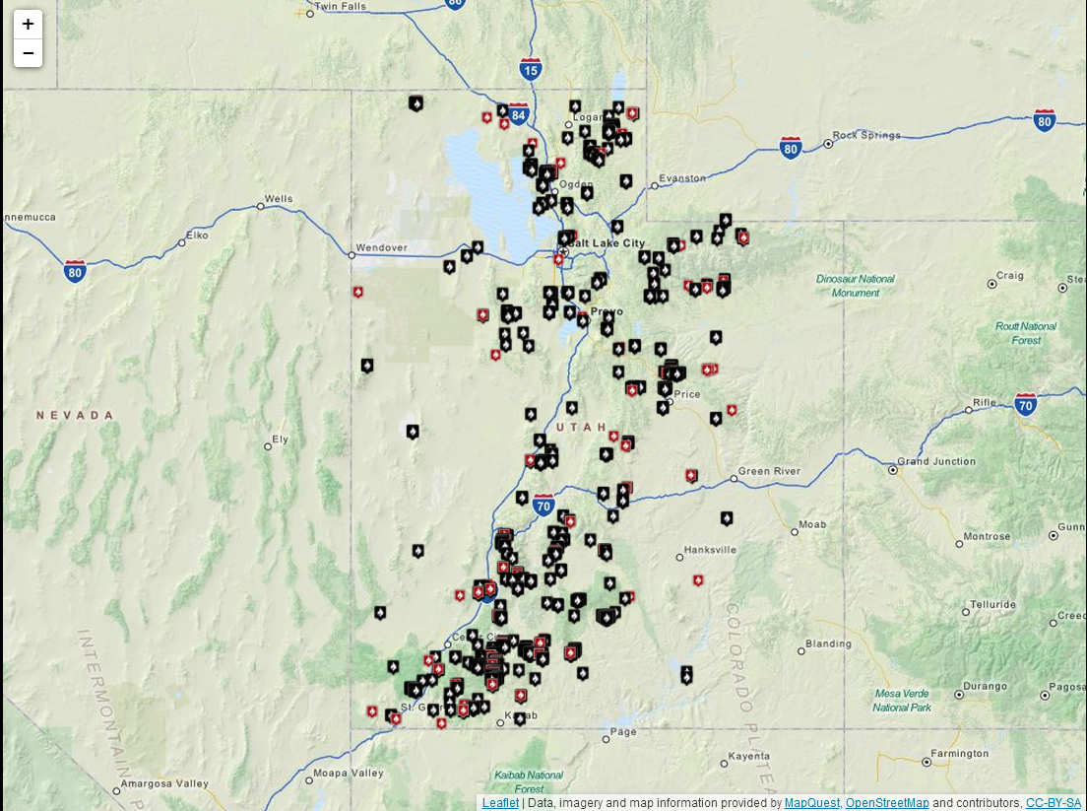
Visualizing forecasts and verifying data
These adjustments also apply to the map markers
http://meso1.chpc.utah.edu/jfsp
Notes:
This map features all of the prescribed burn forecasts for SLC WFO during the period we were examining

Slide 34
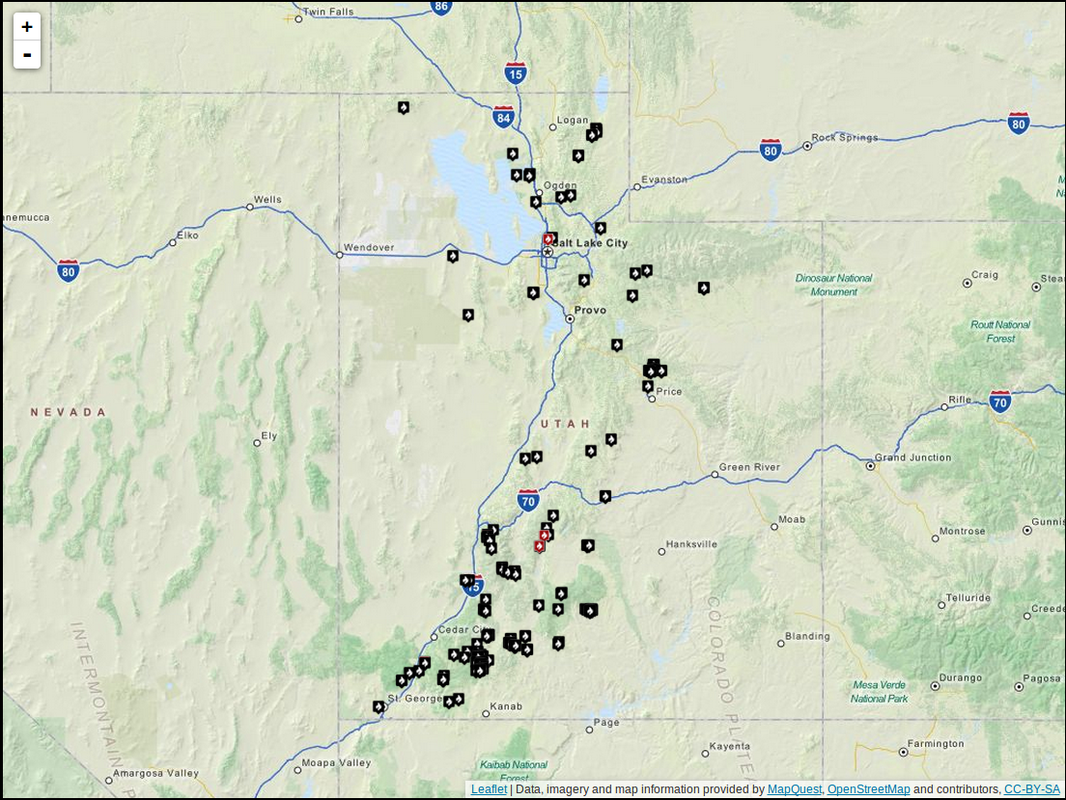
Visualizing forecasts and verifying data
These adjustments also apply to the map markers
http://meso1.chpc.utah.edu/jfsp
Notes:
- And here we see the markers for cases where the forecast maximum wind speed exceeded 10 m/s

Slide 35
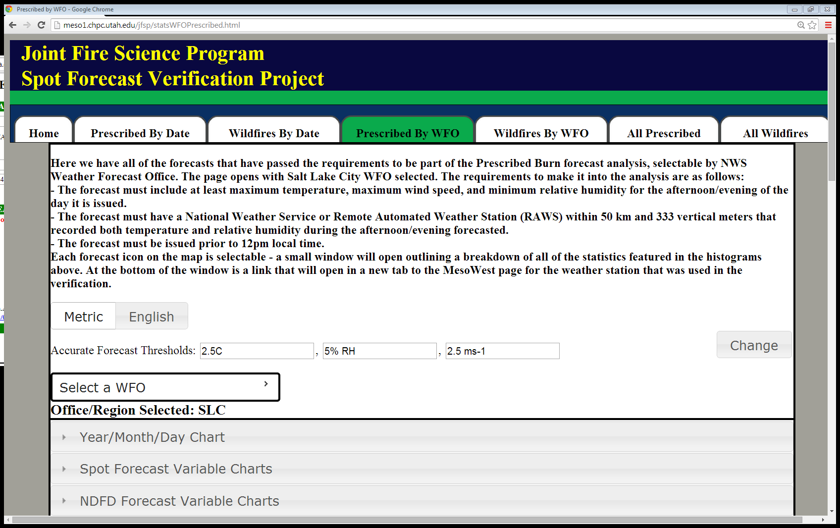
Giving the user control
Why are some markers black and others red?
These are the thresholds used in the evaluation presented here and are the defaults for the web tools
Not universally useful or even reasonable in some cases
Red markers are forecasts where the difference between the forecast and observed values are less than all of the thresholds
Black markers are cases where either temperature, relative humidity, or wind speed forecasts are off from the observation by more than the thresholds.
Notes:
Whereas a 15% limit on relative humidity error might be perfectly acceptable in the Southeast, a 3% error may be more appropriate in a place like Tucson where a forecast of 8% and an observed value of 5% may mean unexpected fire behavior due to fuel curing
In the end, the important thing is to let the user determine which forecasts they want to look at or emphasize

Slide 36
Giving the user control
http://meso1.chpc.utah.edu/jfsp
Notes:
Going back to the map from earlier, we see how many forecasts had an error of greater than one of these thresholds
But what if we don’t want to be this restrictive...what if we doubled the acceptable error?

Slide 37
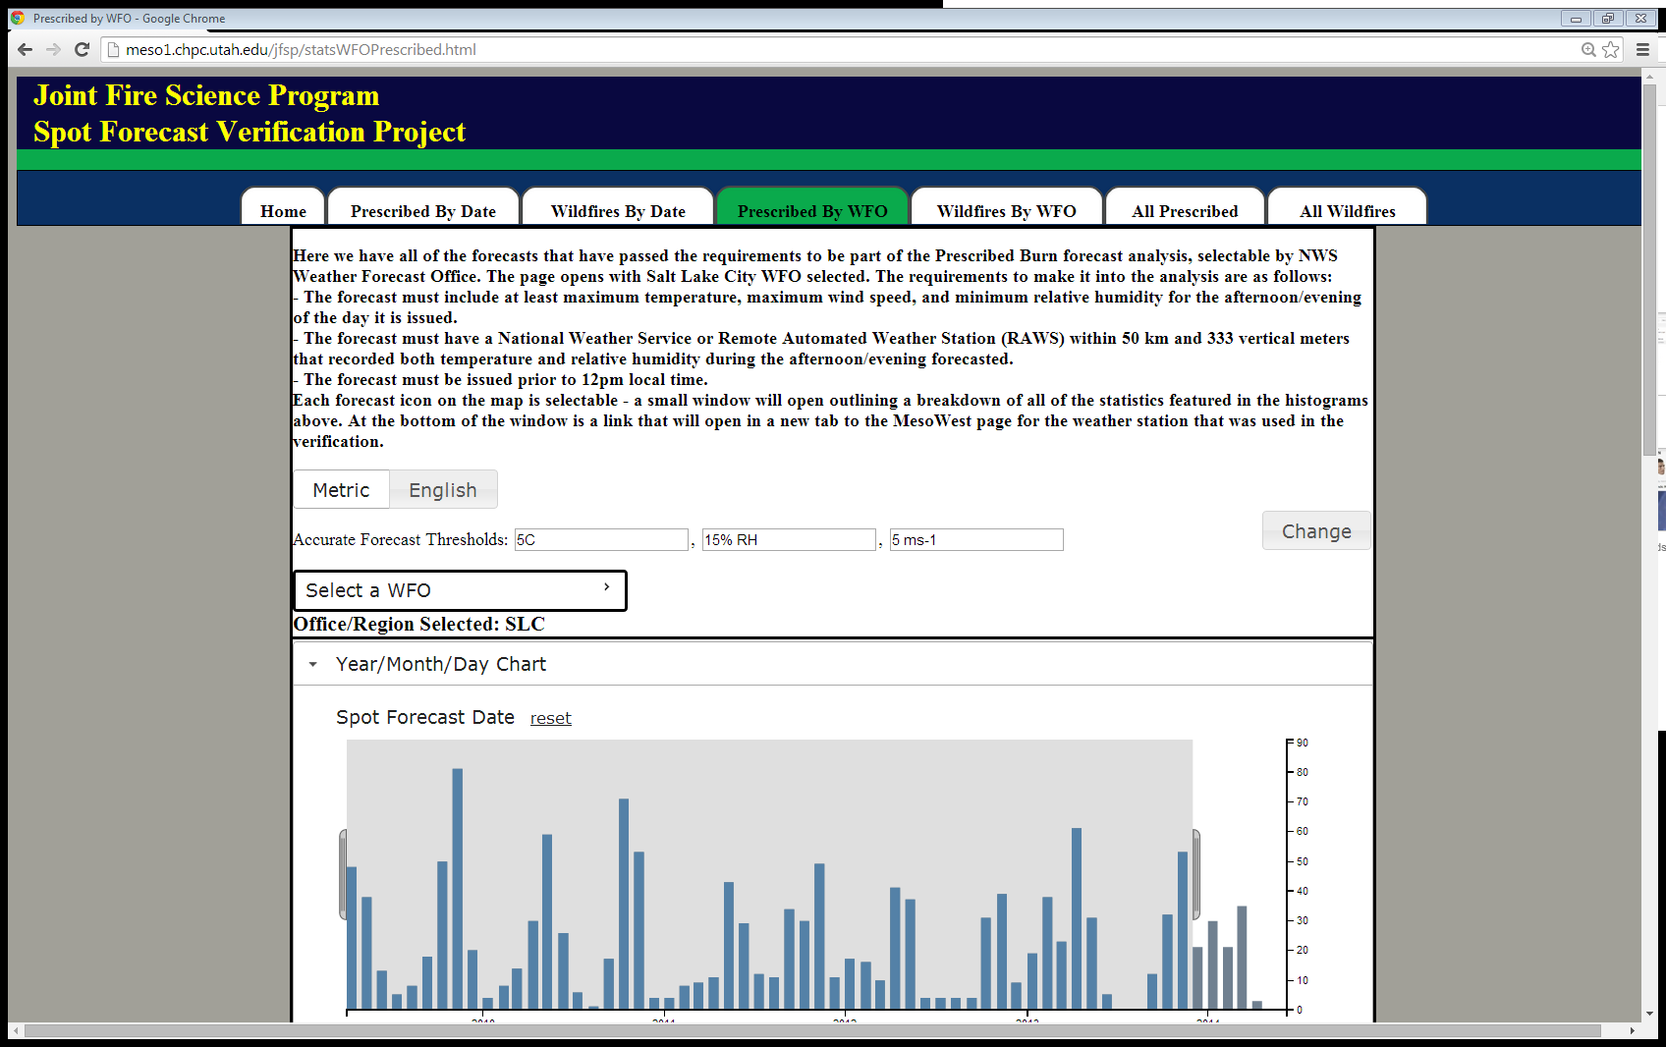
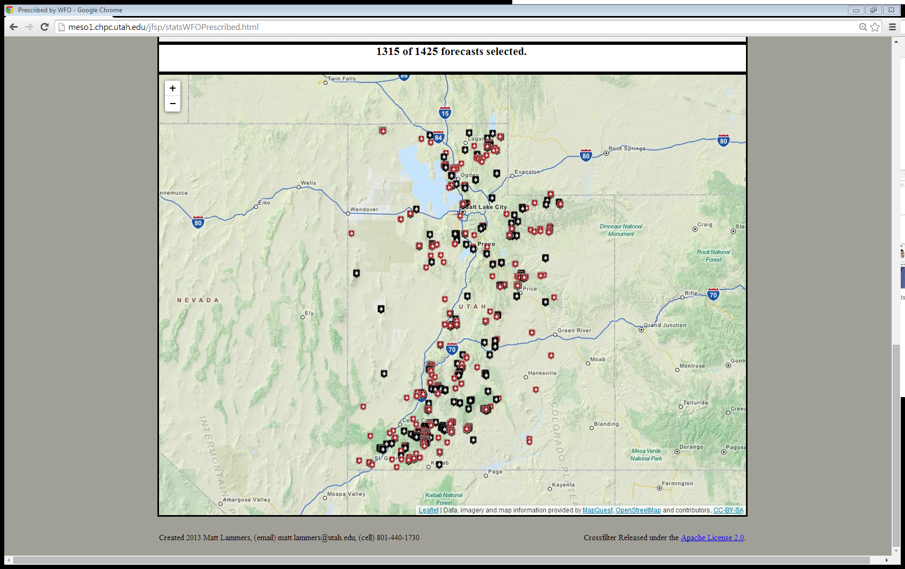
Giving the user control
http://meso1.chpc.utah.edu/jfsp
Notes:
Many of the forecasts that were previously “inaccurate” have now become “accurate” under these new limits

Slide 38
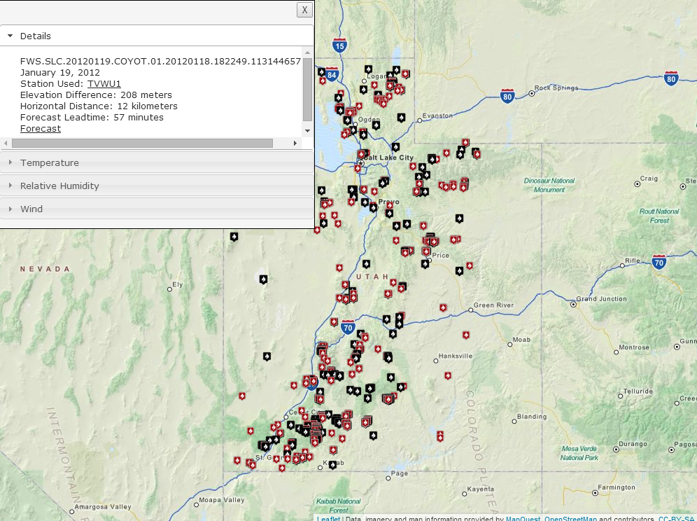
Giving the user control
http://meso1.chpc.utah.edu/jfsp
Notes:
The user can then select a marker to see the different values parsed from the forecast, observed, and taken from the NDFD and RTMA grids, as well as link to the MesoWest page for the verifying observation and look at the original forecast in text form

Slide 39
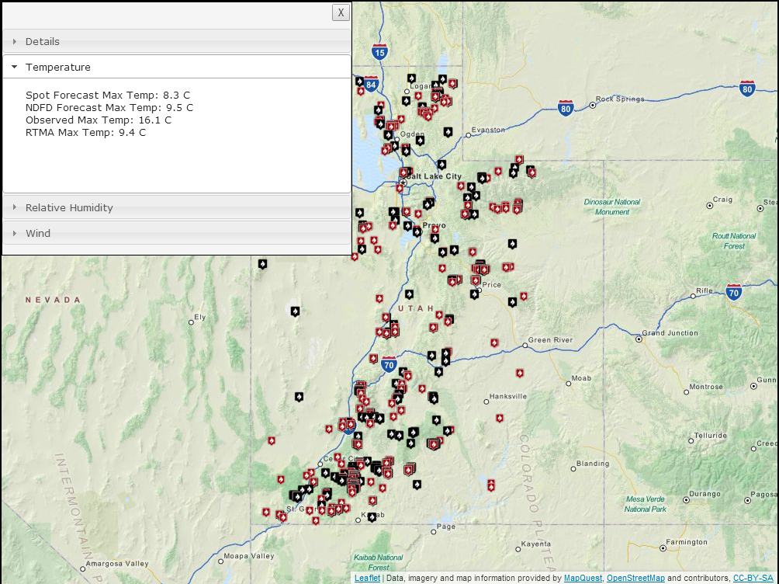
Giving the user control
http://meso1.chpc.utah.edu/jfsp
Notes:
Not only was the temperature error exceeded...

Slide 40
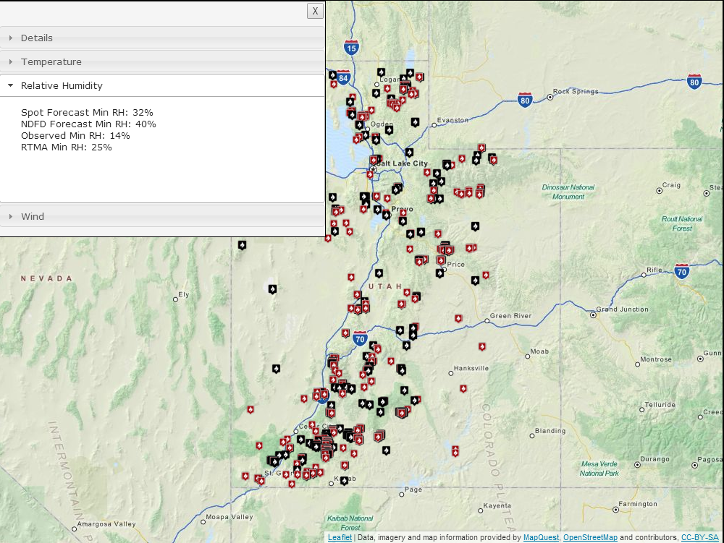
Giving the user control
http://meso1.chpc.utah.edu/jfsp
Notes:
...but also the relative humidity error threshold

Slide 41
Research restrictions
For the sample evaluated in the research, the following restrictions were made:
NDFD and Real-Time Mesoscale Analysis (RTMA, not shown) used were at 5 km grid spacing
NDFD forecasts used were issued at 9 UTC for 6-, 9-, 12-, and 15-hour lead times (for 15, 18, 21, and 24 UTC)
RTMAs used were for 15, 18, 21, and 24 UTC as well
The verifying observation had to be within 50 km and 333 vertical meters of the spot forecast location and elevation

Slide 42
outline
Introduction
Motivation
Objectives
What are Spot Forecasts?
How Do We Verify Spot Forecasts?
Surface Observations
Text Parsing
Visualizing Forecasts and Verifying Data
Giving the User Control
Box Creek Prescribed Burn Escape Case Study
Eureka (EKA) Weather Forecast Office Case Study
All Forecast Offices
Prescribed Burns
Wildfires
Conclusion
Summary
Recommendations
The Transition to Operations

Slide 43
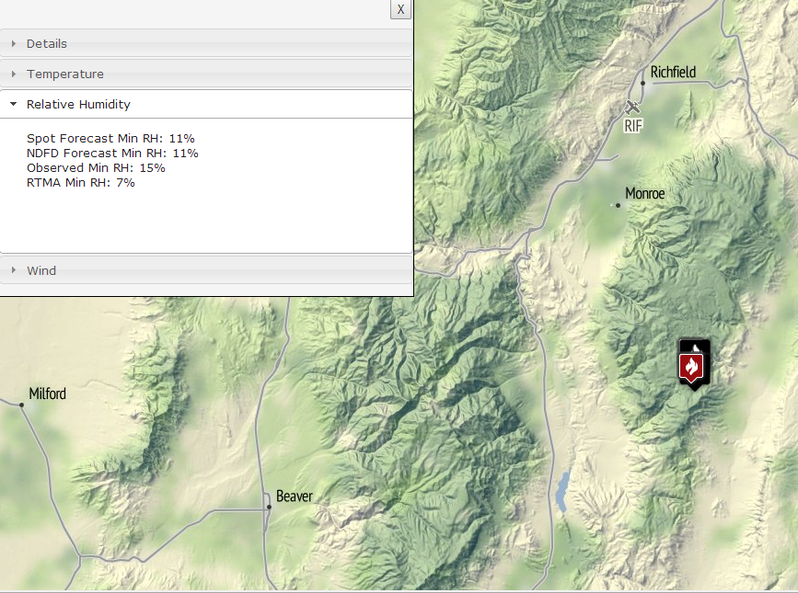
Box creek prescribed burn escape
Box Creek Prescribed Burn
May - June 2012
Fishlake National Forest
Notes:
Lengthy process from test fire to extended burn to escape
Spot forecasts used throughout the period to nail down the on-the-ground conditions
Primary burn begins on May 29, spot fires are detected on 4 June when the fire breaks out of containment

Slide 44
Box creek prescribed burn escape
When a prescribed burn escapes, a Facilitated Learning Analysis (FLA) is often undertaken to assess the factors leading to the loss of containment
In the case of Box Creek, the FLA stated that spot forecasts were requested “and referenced against observed weather conditions and feedback was given to the meteorologist. The spots lined up with conditions on the ground very well. This provided the RXB2 (Burn Boss) with much confidence in the meteorologist’s forecasts” (USFS 2012)
Notes:
These were good forecasts, and there were a large number of them – 23 in all over a five-week period

Slide 45
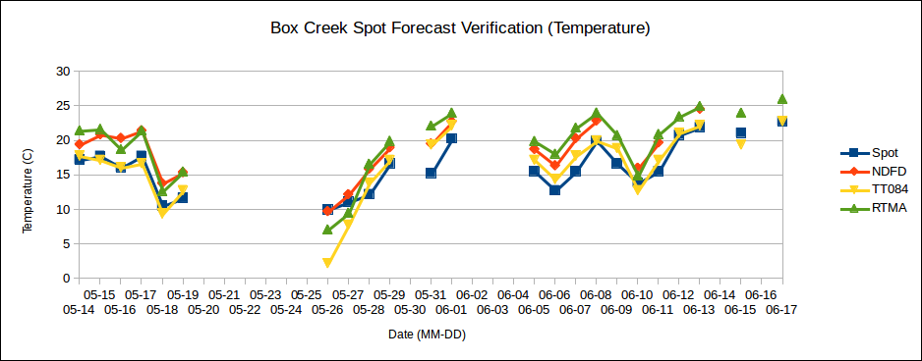
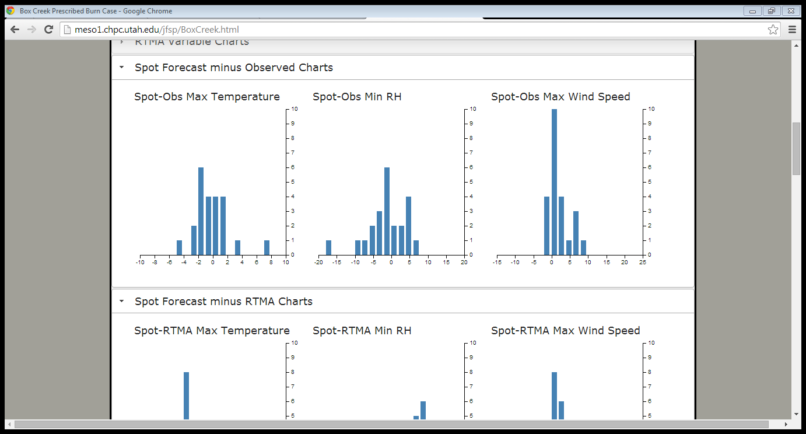
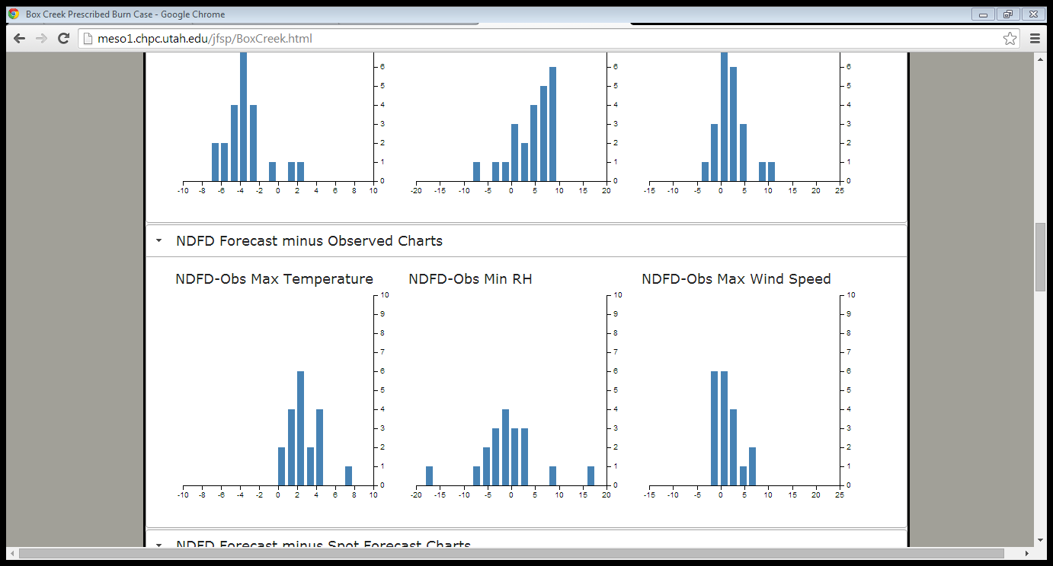
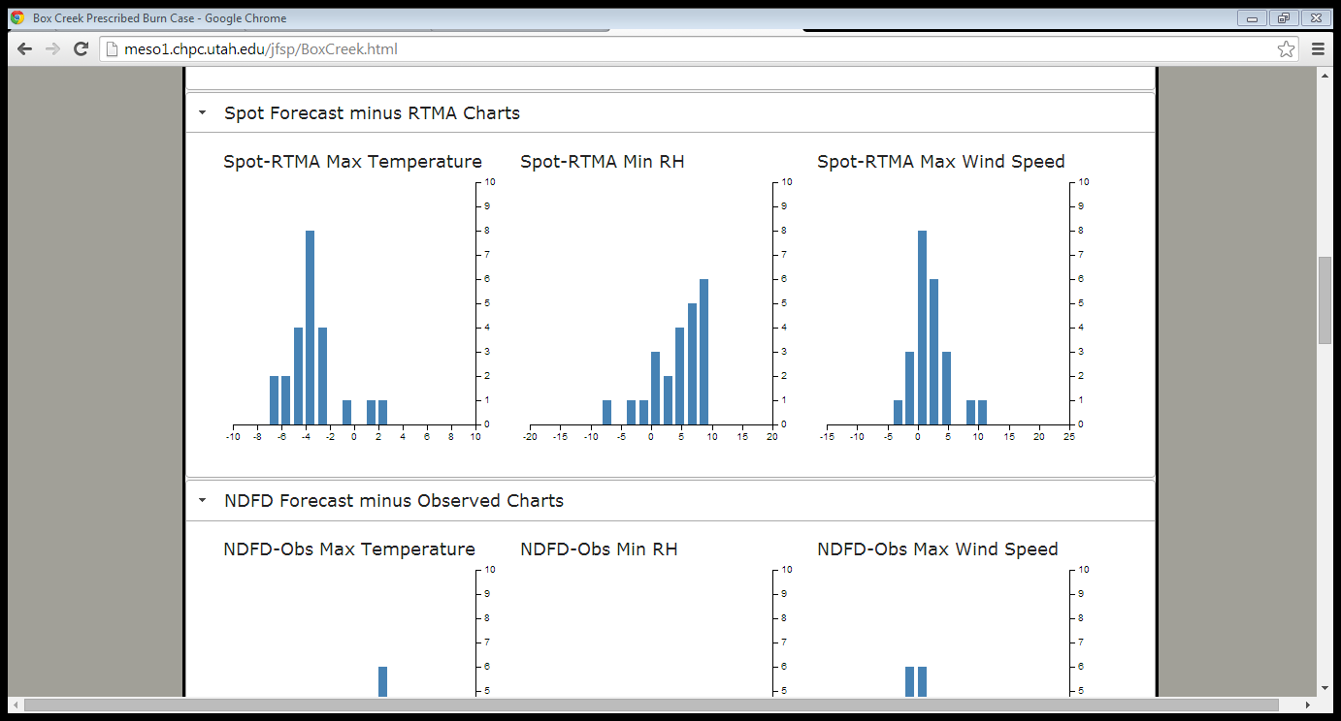
Box Creek
(ºC)
(ºC)
(ºC)
Notes:
Because of the slew of spot forecasts issued, we can look at how the different metrics handled maximum temperature, minimum relative humidity, and maximum wind speed
The verifying observation is TT084 (Fishlake Portable RAWS #4)
Spot forecast maximum temperatures track well with the observations, this is reiterated in histogram below
May 26 stands out as the lone outlier in both the line graph and the histogram
NDFD is always warmer than observation
RTMA is generally warmer than forecast

Slide 46
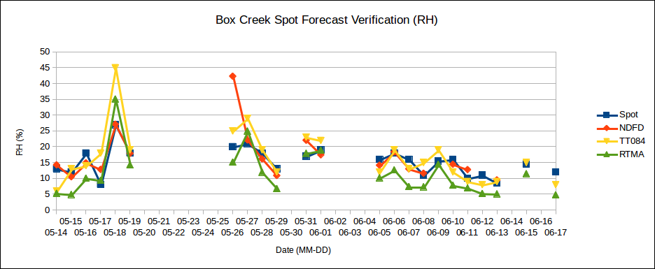
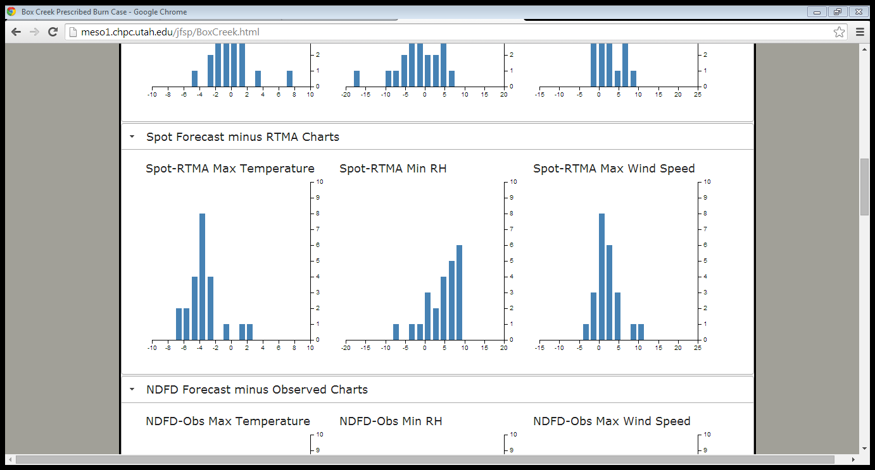
Box Creek
(%)
(%)
(%)
Notes:
Again forecast tracks well with observation
Forecasts are rarely drier than RTMA

Slide 47
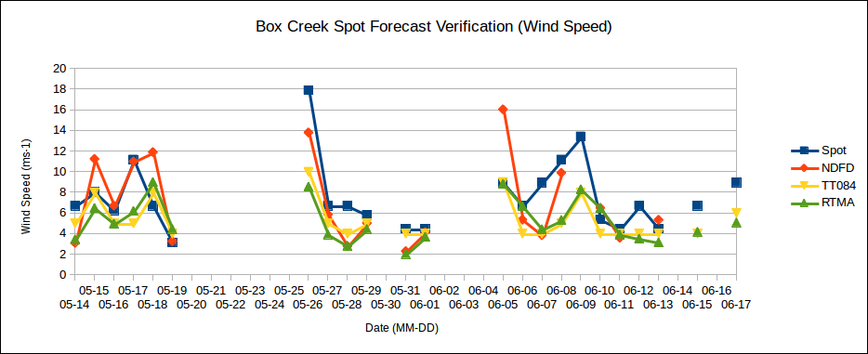
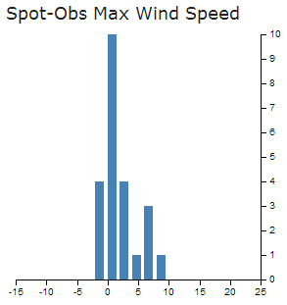
Box Creek
(ms⁻¹)
(ms⁻¹)
(ms⁻¹)
Notes:
Max Wind Speed forecast is generally higher, but this is not necessarily a bad thing

Slide 48
Box creek prescribed burn escape
Out of the 19 Box Creek forecasts for which we have both spot and NDFD guidance, 17 maximum temperature spot forecasts were within 2.5ºC while only 7 maximum temperature NDFD forecasts met the same accuracy threshold
So the “Hit Rate” for spot forecasts would be 17 of 19 and for NDFD forecasts it would be 7 of 19
But what if we want to dig deeper...
Notes:
2.5C is our arbitrary threshold for what we label an “accurate” max temp forecast

Slide 49
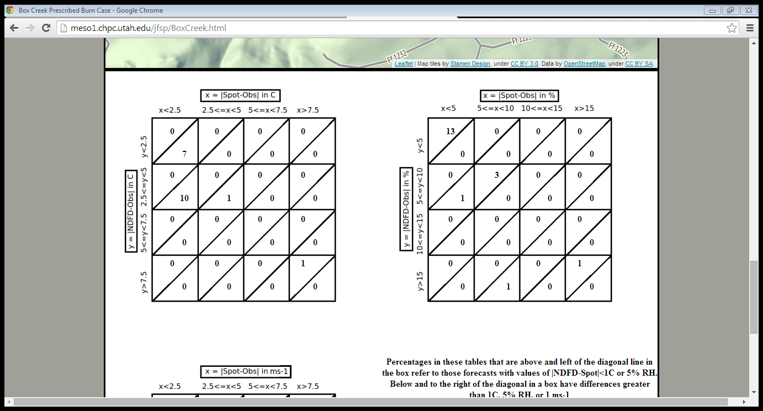
Box creek
Box Creek Temperature
Box Creek Relative Humidity
Count of the number of cases for differences between spot forecasts and observations (columns) and NDFD forecasts and observations (rows)
Values above (below) the diagonal lines in each bin indicate spot forecasts that are within (greater than) 1ºC, 5%, and 1 m s⁻¹
Notes:
Based on tables from Myrick and Horel, 2006
Distributions charts we generate from the results of the verification analysis
Allow us to be able to look at both the number of forecasts with certain levels of error, and to compare the errors between the Spot Forecasts and NDFD Forecasts

Slide 50
Box creek
Box Creek Temperature
Box Creek Relative Humidity
Red Squares are cases where the Spot Forecaster made an improvement over the NDFD forecast relative to the observation.
Blue Squares are cases where the Spot Forecaster modified the forecast and degraded its accuracy versus the NDFD forecast.
Notes:
Green squares are those where the NDFD and spot forecasts performed similarly, with overall accuracy decreasing from top left to bottom right
Breakpoints are arbitrary and should be modified based on what makes sense for the office or region

Slide 51
Box creek
Box Creek Temperature
Temperature Forecast Errors – Spot versus NDFD
9 forecasts where magnitude of error is the same (green)
10 forecasts where the spot improved on the NDFD (red)
0 forecasts where the spot degraded the NDFD (blue)
Notes:
It is clear from the left figure that 17 of the 19 spot forecasts would be considered accurate for temperature, while we can say the same for only 7 of the NDFD forecasts.

Slide 52
Box creek
Box Creek Relative Humidity
Relative Humidity Forecast Errors – Spot versus NDFD
17 forecasts where magnitude of error is the same (green)
1 forecast where the spot improved on the NDFD (red)
0 forecasts where the spot degraded the NDFD (blue)

Slide 53
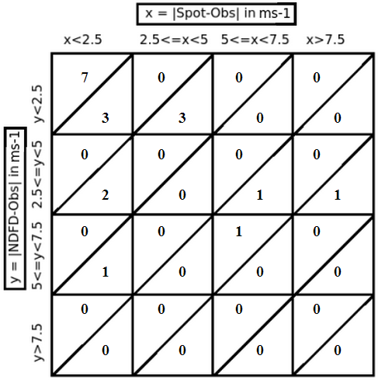
Box creek
Box Creek Wind Speed
Wind Speed Forecast Errors – Spot versus NDFD
11 forecasts where magnitude of error is the same (green)
3 forecasts where the spot improved on the NDFD (red)
3 forecasts where the spot degraded the NDFD (blue)

Slide 54
outline
Introduction
Motivation
Objectives
What are Spot Forecasts?
How Do We Verify Spot Forecasts?
Surface Observations
Text Parsing
Visualizing Forecasts and Verifying Data
Giving the User Control
Box Creek Prescribed Burn Escape Case Study
Eureka (EKA) Weather Forecast Office Case Study
All Forecast Offices
Prescribed Burns
Wildfires
Conclusion
Summary
Recommendations
The Transition to Operations

Slide 55
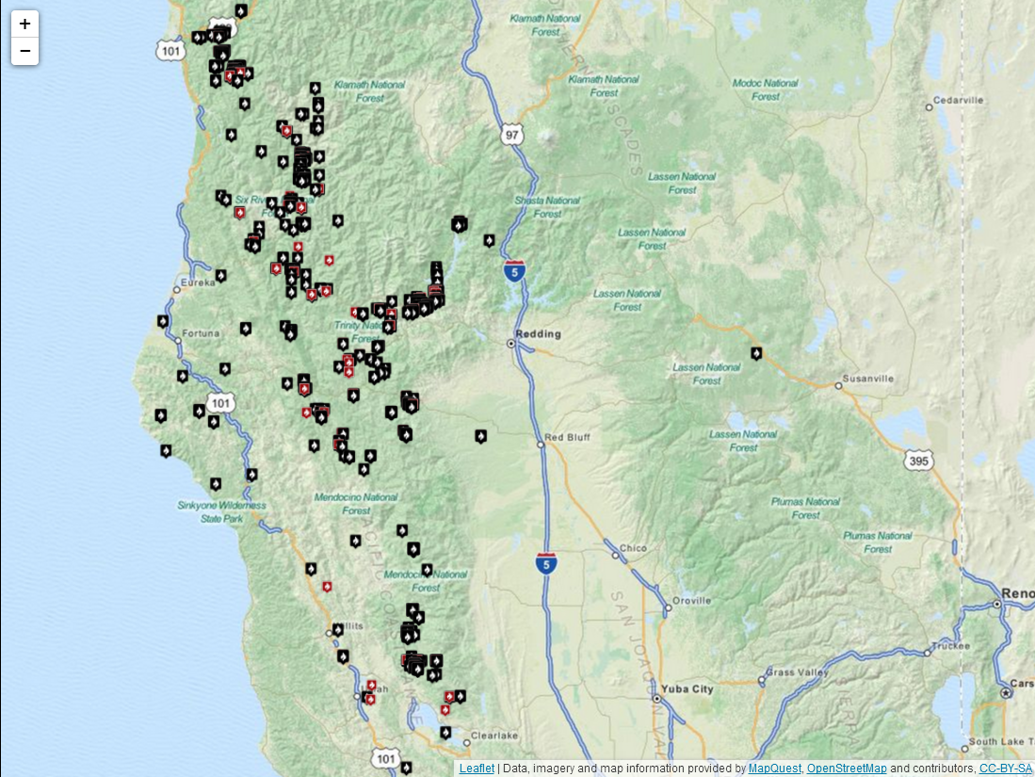
Eureka, CA (EKA)
Prescribed Burn Spot Forecasts from EKA

Slide 56
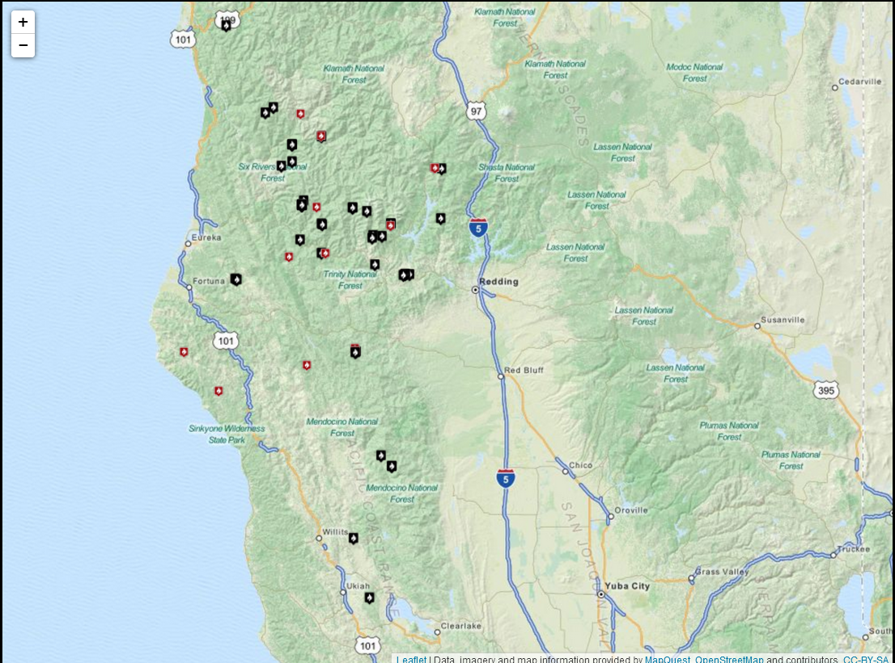
Eureka, CA (EKA)
Wildfire Spot Forecasts from EKA

Slide 57
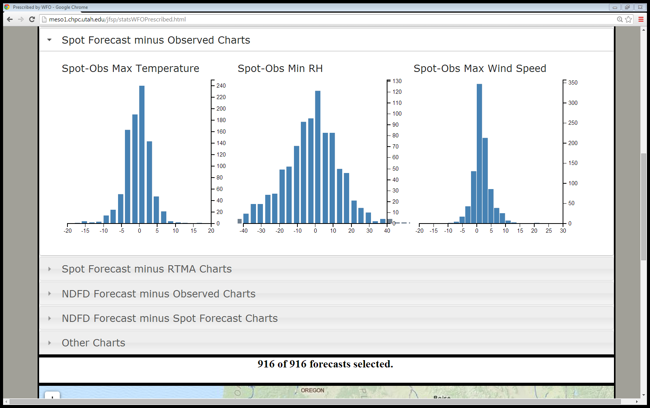
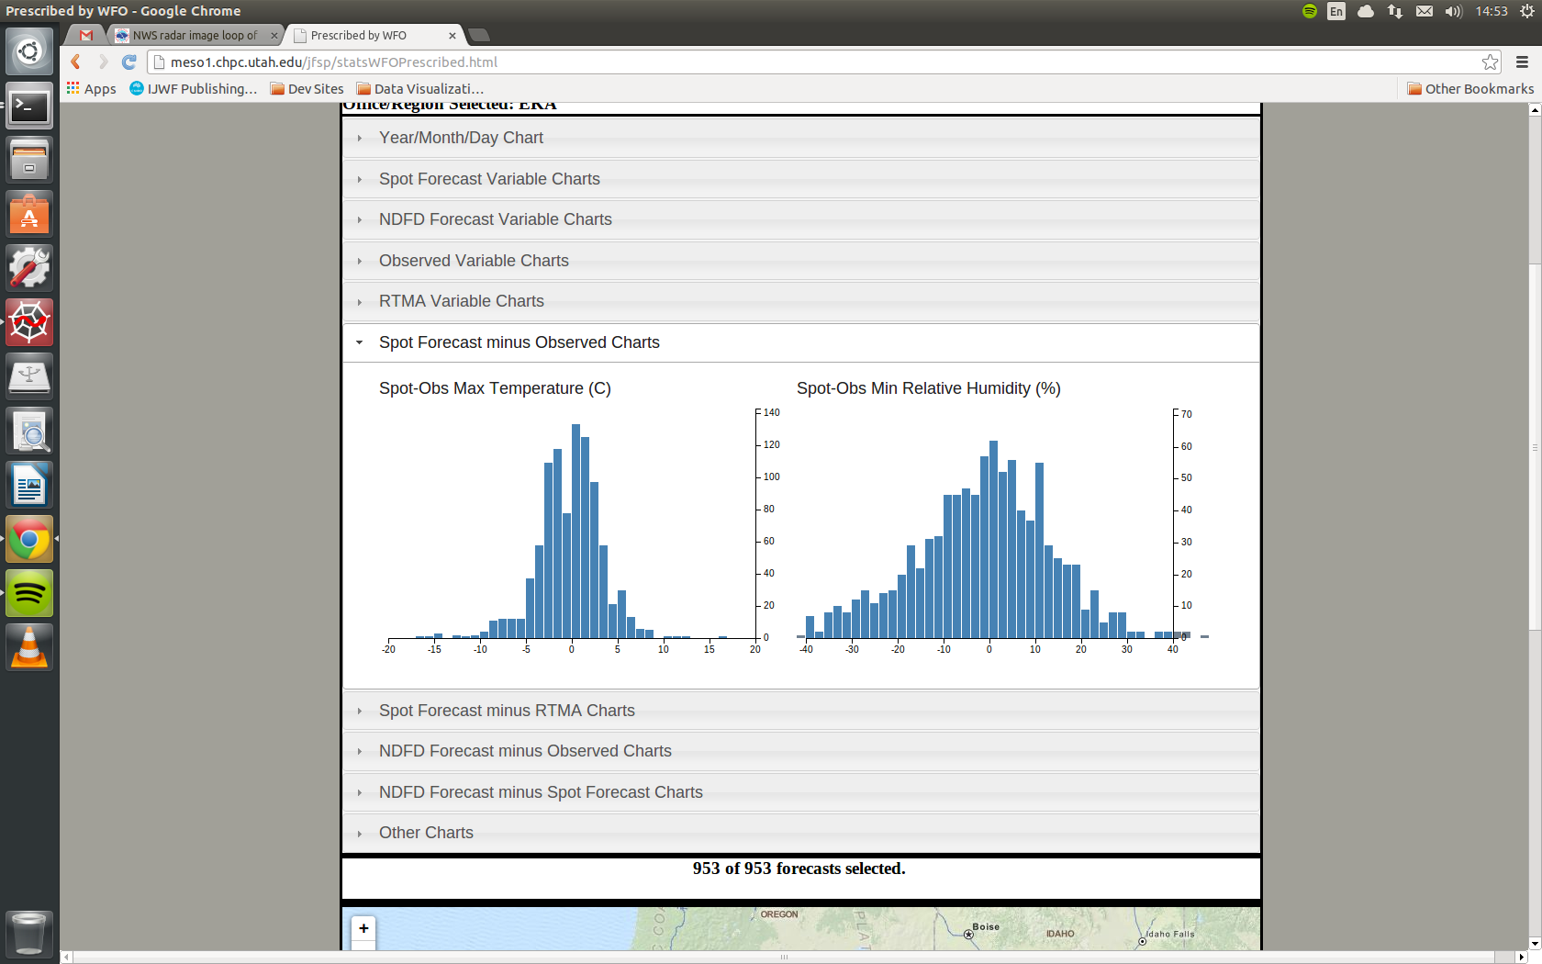
Eureka, CA (EKA)
(ms⁻¹)
Distributions of (Forecast – Observation) Errors for Prescribed Burn Spot Forecasts
Notes:
- Eureka forecasts had a reasonably low bias for RH (-2.3%), but a very large spread in RH errors and a very large Median Absolute Error (10%)

Slide 58
Eureka, CA (EKA)
Again using accuracy for Temperature as 2.5ºC, the Hit Rate for Prescribed Burn Temperature forecasts issued by Eureka WFO is 59.6%, while it is only 52.6% for NDFD Temperature forecasts
Using accuracy for relative humidity as within 5% relative humidity of the observation, the Hit Rate for Prescribed Burn forecasts is only 26.3%

Slide 59
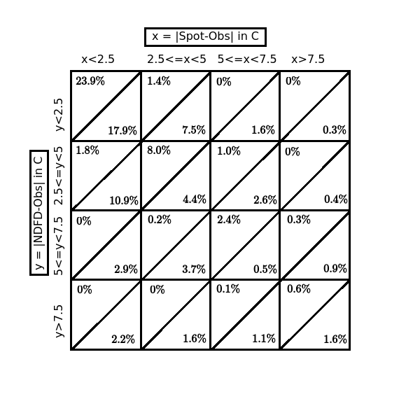
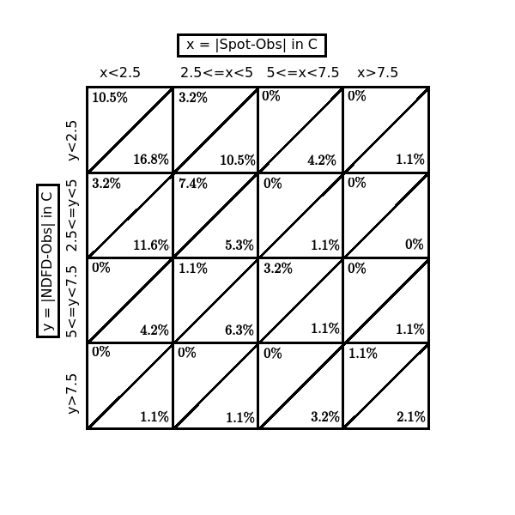
Eureka, CA (EKA)
EKA Prescribed Temperature
EKA Wildfire Temperature
Percentages of the total number of cases for differences between spot forecasts and observation (columns) and NDFD forecasts and observations (rows) for maximum temperature for prescribed burns (left) and wildfires (right).
Notes:
For prescribed burn forecasts, the spot forecasts are more likely to have improved upon the NDFD forecasts (17.8% of forecasts) than degraded the NDFD forecast (10.8%)
For wildfire forecasts, this difference becomes only 1.1% of forecasts

Slide 60
Eureka, CA (EKA)
EKA Prescribed Temperature
EKA Wildfire Temperature
52.6%
46.3%
59.6%
47.4%
The red column is the marginal distribution of accurate spot forecasts, while the blue column is the marginal distribution of accurate NDFD forecasts
Notes:
For prescribed burn forecasts, the spot forecasts are more likely to have improved upon the NDFD forecasts (17.8% of forecasts) than degraded the NDFD forecast (10.8%)
For wildfire forecasts, this difference becomes only 1.1% of forecasts

Slide 61
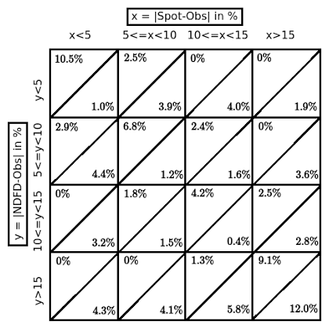
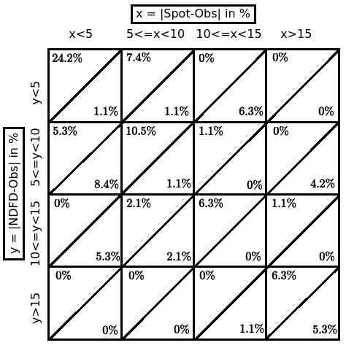
Eureka, CA (EKA)
EKA Prescribed Relative Humidity
EKA Wildfire Relative Humidity
Minimum relative humidity forecasts for prescribed burns (left) and wildfires (right).
Notes:
Green total – 26.3% of forecasts, Purple total – 38.9% of forecasts for prescribed burns
For wildfires these values are 44.3% and 16.9% respectively.

Slide 62
Eureka, CA (EKA)
EKA Prescribed Relative Humidity
EKA Wildfire Relative Humidity
26.3%
38.9%
44.3%
16.9%
There were fewer prescribed burn forecasts with less than 5% relative humidity error (green) than with more than 15% relative humidity error (purple). This is not the case in wildfire forecasts.
Notes:
Green total – 26.3% of forecasts, Purple total – 38.9% of forecasts for prescribed burns
For wildfires these values are 44.3% and 16.9% respectively.

Slide 63
outline
Introduction
Motivation
Objectives
What are Spot Forecasts?
How Do We Verify Spot Forecasts?
Surface Observations
Text Parsing
Visualizing Forecasts and Verifying Data
Giving the User Control
Box Creek Prescribed Burn Escape Case Study
Eureka (EKA) Weather Forecast Office Case Study
All Forecast Offices
Prescribed Burns
Wildfires
Conclusion
Summary
Recommendations
The Transition to Operations

Slide 64
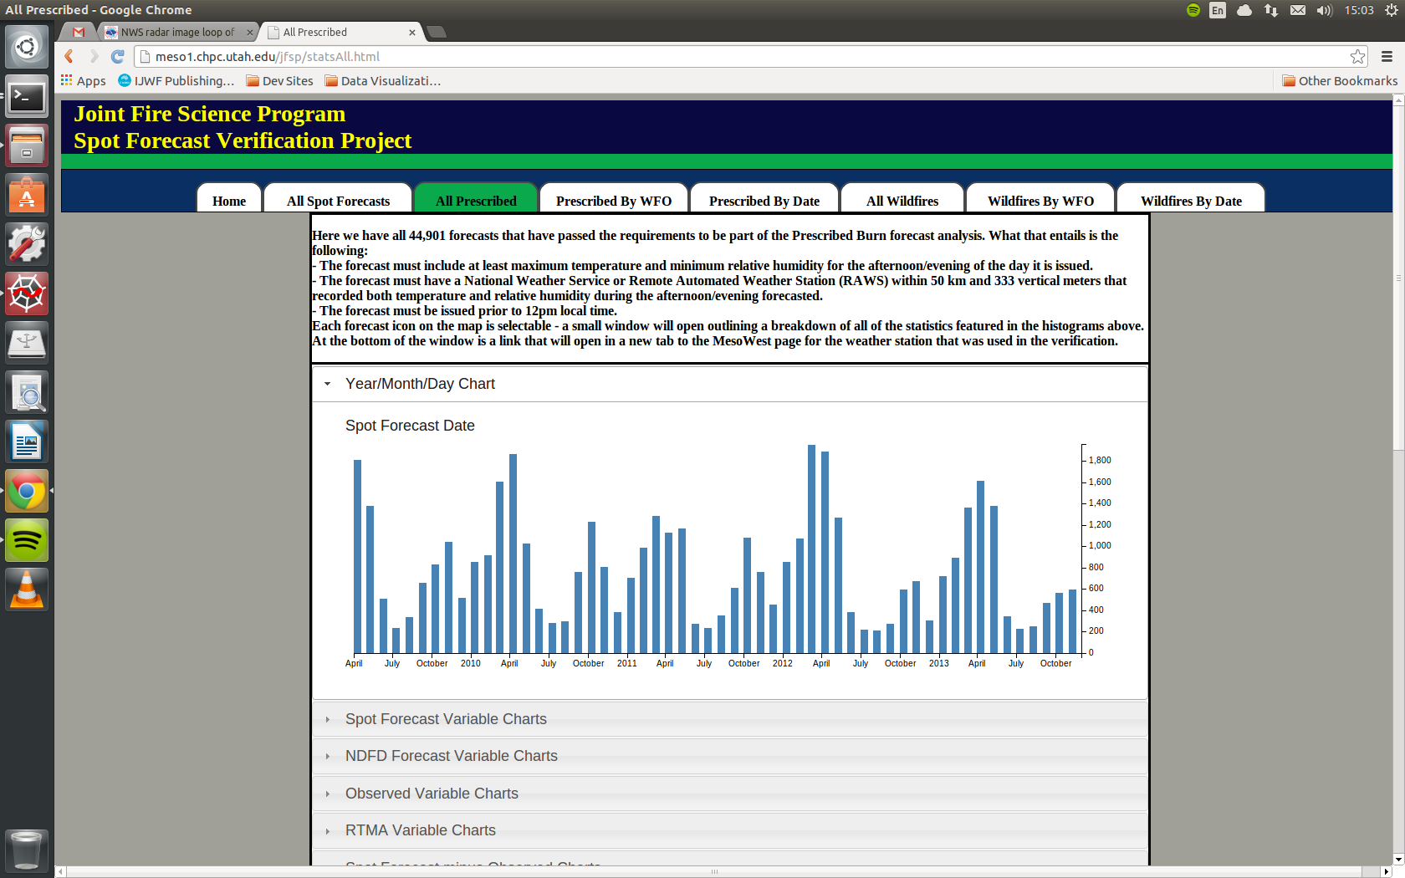
All prescribed burns
Prescribed Burn Spot Forecasts in the analysis broken down by month
Notes:
- Just as a reminder, prescribed burns are geographically much more spread out than wildfires – only a few areas failed to get forecasts into the analysis, while others seem to have an almost unrealistic number of burns
The two highest months for prescribed burns in our analysis were March 2012 and April 2010
Reach a minimum in the mid-summer, typically July or August depending on the year

Slide 65
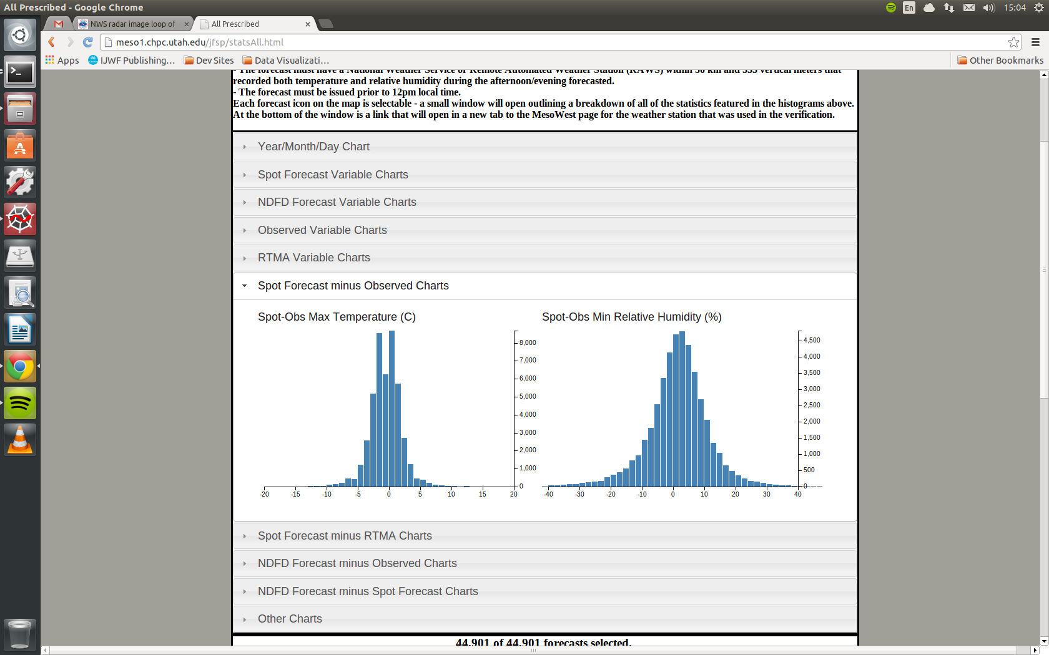
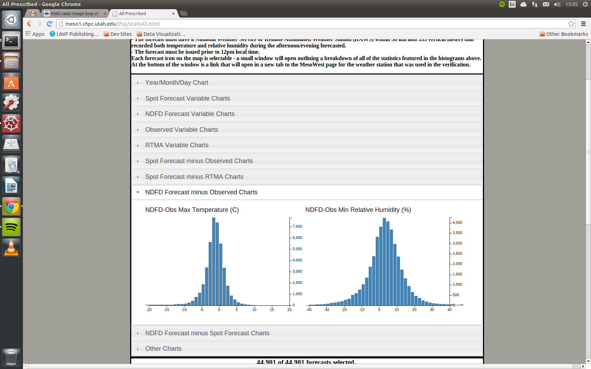
All prescribed burns
NDFD Forecasts have slightly more spread in Temperature Error
Both types of forecasts show a slight cool bias relative to observations
Too Cool
Too Warm
Notes:
NDFD forecasts have slightly more spread in both Temperature and Relative Humidity forecasts
Both NDFD and Spot Forecasts have slight cool, wet bias relative to surface observations

Slide 66
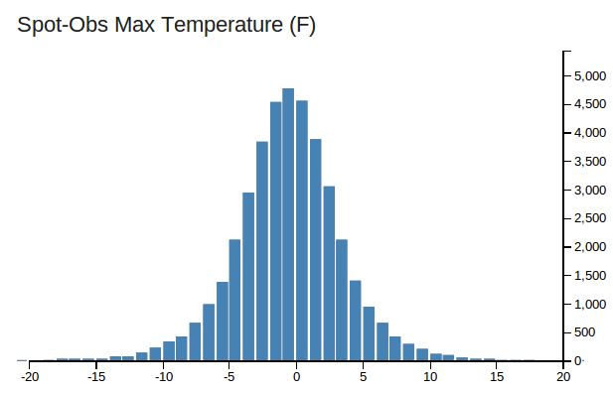
All prescribed burns
If we switch to units of Fahrenheit, the bimodality near the center of the histogram disappears – this is simply an artifact of converting mostly whole number forecast values into Celsius
Too Cool
Too Warm
Notes:
Bimodal appearance of the spot forecast errors is related to conversion from generally whole number Fahrenheit values to Celsius

Slide 67
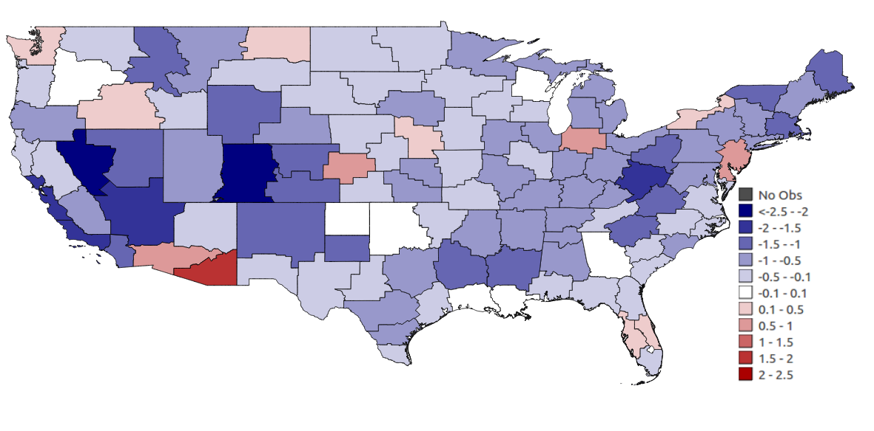
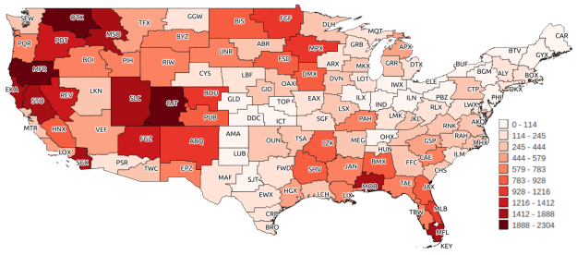
All prescribed burns
Prescribed Burn Spot Forecast Temperature Mean Error by CWA
Forecasts by CWA
Notes:
Tucson has strongest warm bias – covered in thesis
Other offices with warm biases have either very few cases or only a slight bias value.
Runs counter to Brown and Murphy 1987 – looked at fire weather forecasts issued by Boise WFO and saw a general hot/dry bias erring on side of higher fire danger to prepare fire officials

Slide 68
All prescribed burns
Again, NDFD forecasts have higher spread in errors than spot forecasts
Slight but apparent wet bias in both spot forecasts and NDFD forecasts
Too Dry
Too Wet
Notes:
NDFD forecasts have slightly more spread
Both NDFD and Spot Forecasts have slight wet bias relative to surface observations

Slide 69
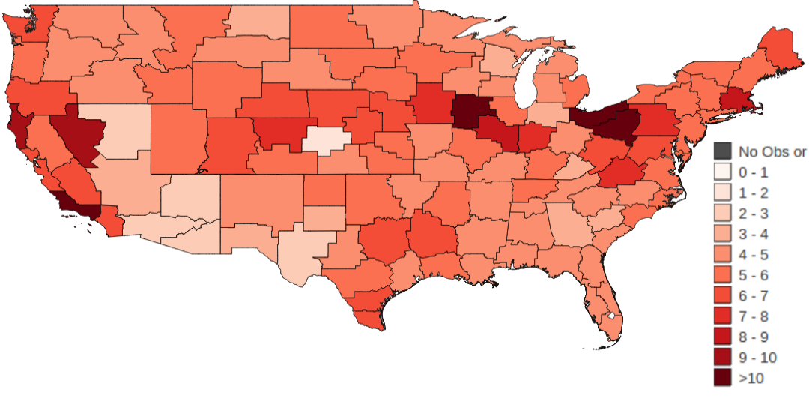
All prescribed burns
Prescribed Burn Spot Forecast RH Median Absolute Error by CWA
Forecasts by CWA
Notes:
In this map, we see the cluster of accurate forecast offices in generally dry regions (Nevada, Arizona, New Mexico)

Slide 70


All prescribed burns
(ms⁻¹)
(ms⁻¹)
Prescribed Burn Spot and NDFD Forecasts against Observations
Notes:
Both are fairly normally distributed, and both have a slight high bias, although only 0.22 m/s for Spot Forecasts and 0.42 m/s for NDFD Forecasts

Slide 71

All prescribed burns
Prescribed Burn Spot Forecast Wind Speed Mean Error by CWA
Forecasts by CWA
Notes:
Unbiased forecast offices are generally in the east, but the larger trends involve the dichotomy between overforecasting in the Mountain West and underforecasting in the Great Plains
The argument has been made that the underforecasting in the plains states could be related to a lack of RAWS stations, so all verifying obs are 3.3 meters above the level at which they are forecasting
In the West, representativeness and localized flows probably play a role

Slide 72
All prescribed burns
 | Number of Forecasts (Spot – Observation) | (Spot – Observation) Mean Error | (Spot – Observation) Median Absolute Error | Number of Forecasts (NDFD – Observation) | (NDFD – Observation) Mean Error | (NDFD – Observation) Median Absolute Error
Prescribed Burn Temperature | 44,901 | -0.53 ºC | 1.33 ºC | 42,924 | -1.72 ºC | 1.69 ºC
Prescribed Burn Relative Humidity | 44,901 | 1.46% | 5.29% | 42,924 | 6.04% | 6.64%
Prescribed Burn Wind Speed | 38,017 | 0.22 m s⁻¹ | 1.34 m s⁻¹ | 35,979 | 0.42 m s⁻¹ | 1.42 m s⁻¹
Wildfire Temperature | 16,280 | -0.37 ºC | 1.67 ºC | 14,680 | -1.46 ºC | 1.99 ºC
Wildfire Relative Humidity | 16,280 | 0.69% | 4.00% | 14,680 | 4.10% | 5.05%
Wildfire Wind Speed | 8,860 | 0.72 m s⁻¹ | 1.50 m s⁻¹ | 8,075 | 0.79 m s⁻¹ | 1.59 m s⁻¹
Aggregate Statistics for Spot and NDFD Forecast Errors relative to Observations
Notes:
Mean Error and Median Absolute Error
Reiterates the different biases and accuracies of the forecasts – spot forecasts on the whole more accurate and less biased than NDFD values

Slide 73
All prescribed burns
 | Number of Forecasts (Spot – Observation) | (Spot – Observation) Mean Error | (Spot – Observation) Median Absolute Error | Number of Forecasts (NDFD – Observation) | (NDFD – Observation) Mean Error | (NDFD – Observation) Median Absolute Error
Prescribed Burn Temperature | 44,901 | -0.53 ºC | 1.33 ºC | 42,924 | -1.72 ºC | 1.69 ºC
Prescribed Burn Relative Humidity | 44,901 | 1.46% | 5.29% | 42,924 | 6.04% | 6.64%
Prescribed Burn Wind Speed | 38,017 | 0.22 m s⁻¹ | 1.34 m s⁻¹ | 35,979 | 0.42 m s⁻¹ | 1.42 m s⁻¹
Wildfire Temperature | 16,280 | -0.37 ºC | 1.67 ºC | 14,680 | -1.46 ºC | 1.99 ºC
Wildfire Relative Humidity | 16,280 | 0.69% | 4.00% | 14,680 | 4.10% | 5.05%
Wildfire Wind Speed | 8,860 | 0.72 m s⁻¹ | 1.50 m s⁻¹ | 8,075 | 0.79 m s⁻¹ | 1.59 m s⁻¹
Aggregate Statistics for Spot and NDFD Forecast Errors relative to Observations
Notes:
Mean Error and Median Absolute Error
Reiterates the different biases and accuracies of the forecasts – spot forecasts on the whole more accurate and less biased than NDFD values

Slide 74
All prescribed burns
 | Number of Forecasts (Spot – Observation) | (Spot – Observation) Mean Error | (Spot – Observation) Median Absolute Error | Number of Forecasts (NDFD – Observation) | (NDFD – Observation) Mean Error | (NDFD – Observation) Median Absolute Error
Prescribed Burn Temperature | 44,901 | -0.53 ºC | 1.33 ºC | 42,924 | -1.72 ºC | 1.69 ºC
Prescribed Burn Relative Humidity | 44,901 | 1.46% | 5.29% | 42,924 | 6.04% | 6.64%
Prescribed Burn Wind Speed | 38,017 | 0.22 m s⁻¹ | 1.34 m s⁻¹ | 35,979 | 0.42 m s⁻¹ | 1.42 m s⁻¹
Wildfire Temperature | 16,280 | -0.37 ºC | 1.67 ºC | 14,680 | -1.46 ºC | 1.99 ºC
Wildfire Relative Humidity | 16,280 | 0.69% | 4.00% | 14,680 | 4.10% | 5.05%
Wildfire Wind Speed | 8,860 | 0.72 m s⁻¹ | 1.50 m s⁻¹ | 8,075 | 0.79 m s⁻¹ | 1.59 m s⁻¹
Aggregate Statistics for Spot and NDFD Forecast Errors relative to Observations
Notes:
Mean Error and Median Absolute Error
Reiterates the different biases and accuracies of the forecasts – spot forecasts on the whole more accurate and less biased than NDFD values

Slide 75
All prescribed burns
 | Accurate Spot Forecasts | Accurate NDFD Forecasts | Difference (Spot – NDFD)
Prescribed Burn Temperature | 75.4% | 65.8% | 9.6%
Prescribed Burn Relative Humidity | 43.9% | 39.2% | 4.7%
Prescribed Burn Wind Speed | 76% | 74.4% | 1.6%
Wildfire Temperature | 66.6% | 59.1% | 7.5%
Wildfire Relative Humidity | 53.3% | 49.5% | 3.8%
Wildfire Wind Speed | 70.4% | 68.8% | 1.6%
Marginal distributions of accurate Spot and NDFD forecasts
“Accurate” is |forecast – observation|<2.5ºC, 5% RH, or 2.5 m s⁻¹
Notes:
First column and first row of the joint distribution charts
Much more improvement for temperature forecasts than RH/wind speed...but temperature accuracy is less important for operations

Slide 76

All WILDFIRES
Wildfire Spot Forecasts in the analysis broken down by month
Notes:
More drastic contrast between high and low season – almost zero forecasts in December/January, while majority of forecasts in July, August, September – max month depends on year
Highest month for wildfire spot forecasts is August 2011

Slide 77


All Wildfires
Wildfire Spot Forecast Temperature Mean Error by CWA
Forecasts by CWA
Notes:
Not the same predominately blue map seen with the prescribed burn forecasts...more offices have warm bias in error
More offices have no cases or a bad case skewing the mean error value

Slide 78

All Wildfires
Wildfire Spot Forecast RH Median Absolute Error by CWA
Forecasts by CWA
Notes:
Offices with more cases generally had better MedAE values, although concentrated heavily in dry regions
Most really bad MAE CWAs have only a couple forecast cases

Slide 79

All Wildfires
Wildfire Burn Spot Forecast Wind Speed Mean Error by WFO
Forecasts by CWA
Notes:
Less underforecasting bias in Great Plains, but also fewer forecasts, so skewed toward just a couple cases

Slide 80
All wildfires
 | Number of Forecasts (Spot – Observation) | (Spot – Observation) Mean Error | (Spot – Observation) Median Absolute Error | Number of Forecasts (NDFD – Observation) | (NDFD – Observation) Mean Error | (NDFD – Observation) Median Absolute Error
Prescribed Burn Temperature | 44,901 | -0.53 ºC | 1.33 ºC | 42,924 | -1.72 ºC | 1.69 ºC
Prescribed Burn Relative Humidity | 44,901 | 1.46% | 5.29% | 42,924 | 6.04% | 6.64%
Prescribed Burn Wind Speed | 38,017 | 0.22 m s⁻¹ | 1.34 m s⁻¹ | 35,979 | 0.42 m s⁻¹ | 1.42 m s⁻¹
Wildfire Temperature | 16,280 | -0.37 ºC | 1.67 ºC | 14,680 | -1.46 ºC | 1.99 ºC
Wildfire Relative Humidity | 16,280 | 0.69% | 4.00% | 14,680 | 4.10% | 5.05%
Wildfire Wind Speed | 8,860 | 0.72 m s⁻¹ | 1.50 m s⁻¹ | 8,075 | 0.79 m s⁻¹ | 1.59 m s⁻¹
Aggregate Statistics for Spot and NDFD Forecast Errors relative to Observations
Notes:
Spot forecasts still less biased and more accurate than NDFD forecasts, note that relative to RTMA, accuracy is similar, but bias is completely flipped

Slide 81
All wildfires
 | Number of Forecasts (Spot – Observation) | (Spot – Observation) Mean Error | (Spot – Observation) Median Absolute Error | Number of Forecasts (NDFD – Observation) | (NDFD – Observation) Mean Error | (NDFD – Observation) Median Absolute Error
Prescribed Burn Temperature | 44,901 | -0.53 ºC | 1.33 ºC | 42,924 | -1.72 ºC | 1.69 ºC
Prescribed Burn Relative Humidity | 44,901 | 1.46% | 5.29% | 42,924 | 6.04% | 6.64%
Prescribed Burn Wind Speed | 38,017 | 0.22 m s⁻¹ | 1.34 m s⁻¹ | 35,979 | 0.42 m s⁻¹ | 1.42 m s⁻¹
Wildfire Temperature | 16,280 | -0.37 ºC | 1.67 ºC | 14,680 | -1.46 ºC | 1.99 ºC
Wildfire Relative Humidity | 16,280 | 0.69% | 4.00% | 14,680 | 4.10% | 5.05%
Wildfire Wind Speed | 8,860 | 0.72 m s⁻¹ | 1.50 m s⁻¹ | 8,075 | 0.79 m s⁻¹ | 1.59 m s⁻¹
Aggregate Statistics for Spot and NDFD Forecast Errors relative to Observations
Notes:
Spot forecasts still less biased and more accurate than NDFD forecasts, note that relative to RTMA, accuracy is similar, but bias is completely flipped

Slide 82
All wildfires
 | Number of Forecasts (Spot – Observation) | (Spot – Observation) Mean Error | (Spot – Observation) Median Absolute Error | Number of Forecasts (NDFD – Observation) | (NDFD – Observation) Mean Error | (NDFD – Observation) Median Absolute Error
Prescribed Burn Temperature | 44,901 | -0.53 ºC | 1.33 ºC | 42,924 | -1.72 ºC | 1.69 ºC
Prescribed Burn Relative Humidity | 44,901 | 1.46% | 5.29% | 42,924 | 6.04% | 6.64%
Prescribed Burn Wind Speed | 38,017 | 0.22 m s⁻¹ | 1.34 m s⁻¹ | 35,979 | 0.42 m s⁻¹ | 1.42 m s⁻¹
Wildfire Temperature | 16,280 | -0.37 ºC | 1.67 ºC | 14,680 | -1.46 ºC | 1.99 ºC
Wildfire Relative Humidity | 16,280 | 0.69% | 4.00% | 14,680 | 4.10% | 5.05%
Wildfire Wind Speed | 8,860 | 0.72 m s⁻¹ | 1.50 m s⁻¹ | 8,075 | 0.79 m s⁻¹ | 1.59 m s⁻¹
Aggregate Statistics for Spot and NDFD Forecast Errors relative to Observations
Notes:
Spot forecasts still less biased and more accurate than NDFD forecasts, note that relative to RTMA, accuracy is similar, but bias is completely flipped

Slide 83
All wildfires
 | Accurate Spot Forecasts | Accurate NDFD Forecasts | Difference (Spot – NDFD)
Prescribed Burn Temperature | 75.4% | 65.8% | 9.6%
Prescribed Burn Relative Humidity | 43.9% | 39.2% | 4.7%
Prescribed Burn Wind Speed | 76% | 74.4% | 1.6%
Wildfire Temperature | 66.6% | 59.1% | 7.5%
Wildfire Relative Humidity | 53.3% | 49.5% | 3.8%
Wildfire Wind Speed | 70.4% | 68.8% | 1.6%
Marginal distributions of accurate Spot and NDFD forecasts
“Accurate” is |forecast – observation|<2.5ºC, 5% RH, or 2.5 m s⁻¹
Notes:
Temperature less improved over NDFD than with prescribed burns; more accurate RH forecasts than with prescribed burns

Slide 84
outline
Introduction
Motivation
Objectives
What are Spot Forecasts?
How Do We Verify Spot Forecasts?
Surface Observations
Text Parsing
Visualizing Forecasts and Verifying Data
Giving the User Control
Box Creek Prescribed Burn Escape Case Study
Eureka (EKA) Weather Forecast Office Case Study
All Forecast Offices
Prescribed Burns
Wildfires
Conclusion
Summary
Recommendations
The Transition to Operations

Slide 85
summary
It is possible to develop a methodology for verifying text-based spot forecasts in an automated fashion using both surface-based observations and model analysis.
Verification of spot forecasts requires detailed exploration that can be facilitated using the web tools developed in the process of this research. These tools can be transitioned to operational use.
Research continues at Desert Research Institute into verification of upper-air variables in spot forecasts.
Aggregate statistics indicate that spot forecasters are adding value above the NDFD gridded values, more so for temperature than for relative humidity and wind speed.

Slide 86



Recommendations
Consistent and clear wind levels should be standard for all spot forecasts – “20 Foot” winds are generally used, but there are offices that exclusively forecast “Eye Level” or even “General” winds
Local forecasts can have varying parameters available for request, but wind level should be clear upon request

Slide 87

Recommendations
Make clear distinctions between numerical values and words/alphabetical phrases in the forecasts to ease verification
This includes separating “gust” values from sustained wind forecasts
Allow the Graphical Forecast Editor (GFE) to populate numerical values and focus forecaster attention on developing the Discussion section
90% of forecasts are evaluated with current parsing system, capturing final 10% requires these revisions

Slide 88

Recommendations
Every spot forecast has the opportunity for feedback
There should be a way for this subjective feedback to be incorporated into the verification process
Remarks from request page should be targeted at specific factors (previous forecast accuracy; station used for comparison)

Slide 89
the transition to operations
Evaluation of further aspects of the spot forecasts can be implemented upon transitioning into operational service – these include verifying other forecast periods and leveraging other verification tools
This has illustrated the feasibility of daily-updating verification of spot forecasts with a user-friendly web interface available for integration within the Performance Branch

Slide 90

the transition to operations
Prescribed Burn Spot Forecasts from Yesterday

Slide 91
Acknowledgements
Joint Fire Science Program
Dr. John Horel
Dr. Court Strong, Dr. Tim Brown
Virgil Middendorf
MesoWest Group
Family and Friends

Slide 92
Questions???

Slide 93

All Prescribed Burns
All Prescribed Temperature
Temperature Forecast Errors – Spot versus NDFD
Manual intervention by the spot forecaster improved on the NDFD 16.1% of the time (red) while it degrades the NDFD in only 6.5% of forecasts (blue).
Of note are the 2.8% of forecasts where the NDFD deviated from observations by more than 7.5ºC (bottom left).

Slide 94


Eureka, CA (EKA)
Distributions of (Forecast – RTMA) Errors
Prescribed Burns
Wildfires
Notes:
- Mean Error shifts farther into the negative compared to the RTMA – note almost zero cases where forecast 30% greater than RTMA

Slide 95

Verifying datasets - gridded analysis
The Real-Time Mesoscale Analysis (RTMA) provides hourly analyses of surface atmospheric variables (de Pondeca et al. 2011)
Notes:
Used at 5km resolution
Provides comparison with surface observation within a couple km of the spot forecast site

Slide 96


All wildfires
NDFD Forecasts more biased than spot forecasts
Spread in NDFD is wider with more forecasts in extreme lobes (especially negative) and less in the largest bins (max bin in NDFD is ~2200, closer to 2700 in spot forecasts)
Too Cool
Too Warm
Notes:
Again, bimodal distribution of temperature errors due to conversion from Fahrenheit to Celsius
Maximum bin for Spot forecasts is 0 - 1C, maximum bin for NDFD is -2 - -1C, apparent cold bias in NDFD is not spurious, Mean Error is -1.46C
Mean Error for Spot forecasts is -0.37C,

Slide 97
All wildfires
NDFD wet bias is much more obvious than spot forecast bias
Spot forecasts have a few more instances in the -30% to -40% range while NDFD has more forecasts in the +30% to +40% error range

Slide 98


All wildfires
Prescribed Burn Spot and NDFD Forecasts against Observations
Notes:
Both have similar mean error values, slight overforecasting bias, perhaps related to desire to “prepare for the worst”
Less opportunity for negative impact in case of wildfires for overforecasting maximum wind than there is for prescribed burn, although still potential to err on the conservative side for containment if wind speed overforecast

Slide 99


Eureka, CA (EKA)
Maximum wind speed forecasts for prescribed burns (left) and wildfires (right). Prescribed burn spot forecasts degrade NDFD (blue) more often than they improve upon it (red). Wildfire wind speed forecasts are generally accurate, with no errors greater than 7.5 m s⁻¹ (orange).
Notes:
Prescribed burn total – 14.4%, NDFD total 18.9%
Prescribed burn errors are much more often overforecasts

Slide 100

Eureka, CA (EKA) – Mill Creek
Spot Forecast Location
Big Hill RAWS Station
Notes:
- Forecast was issued on 24 October 2011
- The station and the prescribed burn are separated by a mere 8 kilometers and 225 vertical meters

Slide 101


Eureka, CA (EKA) – Mill Creek
Temperature
Relative Humidity
Notes:
Even if we say that the observation has issues, the gridded RTMA does not approach the 26% Minimum RH forecast by Eureka WFO
This is corroborated by the Temperature graph
Observation suggests it getting no lower than 65%, which is more likely given the region and time of year.

Slide 102

All Prescribed Burns
Relative Humidity Forecast Errors – Spot versus NDFD
Manual intervention by the spot forecaster improved on the NDFD 16.1% of the time (red) while it degrades the NDFD in only 6.5% of forecasts (blue).
Of note are the 2.8% of forecasts where the NDFD deviated from observations by more than 7.5ºC (bottom left).

Slide 103

All Prescribed Burns
Wind Speed Forecast Errors – Spot versus NDFD
1 ms⁻¹ breakpoint within each square between top-left and bottom-right triangles
Spot forecast improves upon NDFD in 13.1% of cases, while NDFD performs better than spot in 11% of cases.
Notes:
Spot improves upon NDFD in 13.1% of cases, NDFD has less error than spot in 11% of cases

Slide 104
All Prescribed Burns
Wind Speed Forecast Errors – Spot versus NDFD
1 ms⁻¹ breakpoint within each square between top-left and bottom-right triangles
Spot forecast improves upon NDFD in 13.1% of cases, while NDFD performs better than spot in 11% of cases.
Notes:
Spot improves upon NDFD in 13.1% of cases, NDFD has less error than spot in 11% of cases

Slide 105

All wildfires
Temperature Forecast Errors – Spot versus NDFD
Greater percent of wildfire cases featured change of greater than 1⁰C than in prescribed burn cases (58.2% versus 46.2%)
Fewer cases where both forecasts are “good” (48.3% versus 59.3%)

Slide 106
All wildfires
Temperature Forecast Errors – Spot versus NDFD
Greater percent of wildfire cases featured change of greater than 1⁰C than in prescribed burn cases (58.2% versus 46.2%)
Fewer cases where both forecasts are “good” (48.3% versus 59.3%)

Slide 107

All wildfires
Relative Humidity Forecast Errors – Spot versus NDFD
Surprisingly large number of cases where both the NDFD and Spot Forecast were off by greater than 15% (5.3%) – could be poor forecasts or poor verification stations

Slide 108

All wildfires
Wind Speed Forecast Errors – Spot versus NDFD
More cases in which NDFD did well and spot forecast had Class 3 error (0.6%) than cases where spot forecast did well and NDFD had Class 3 error (0.1%)

Slide 109

All prescribed burns
Prescribed Burn Spot Forecast Temperature Median Absolute Error by WFO

Slide 110

All prescribed burns
Prescribed Burn Spot Forecast RH Mean Error by WFO
Notes:
Generally wet biased except select WFOs, including those in Northern Plains, Desert Southwest

Slide 111

Spot Forecasts
All Rx Burn Spot Forecasts April 1, 2009 to November 30, 2013 (64346)

Slide 112

Spot Forecasts
All Wildfire Spot Forecasts April 1, 2009 to November 30, 2013 (31290)

Slide 113

Spot Forecasts
All SAR & Hazmat Spot Forecasts April 1, 2009 to November 30, 2013 (7276)

Slide 114

Prescribed Burn Forecasts

Slide 115

Wildfire forecasts

Slide 116

Verifying Datasets - NDFD
Example NDFD Gridded Temperature Forecast
Notes:
- Note the discontinuities on WFO borders and the immediate ending on national borders

